Slide 1
Concur Travel & Expense Updates
FOR STUDENTS
HAS Student PRESENTATION – Business office

Slide 2
PROCARD
Currently only 1 in the Department, held by Cindy
Available for use by HAS Employees for operational expenses (less than $10K) including Abstract Fees, Registration Fees, Member Dues, Poster Printing
This card CANNOT be used for any travel purchases

Slide 3
PROCARD USE
On Business Office Door & Website is link to ‘Checkout’ the ProCard if you plan to use this card for items such as Abstract & Registration Fees
If you want to use this card, submit the ‘Checkout’ and be prepared with an Account Code from your PI and a detailed Business Purpose that shows the benefit to the University
Link for ProCard Checkout HERE

Slide 4
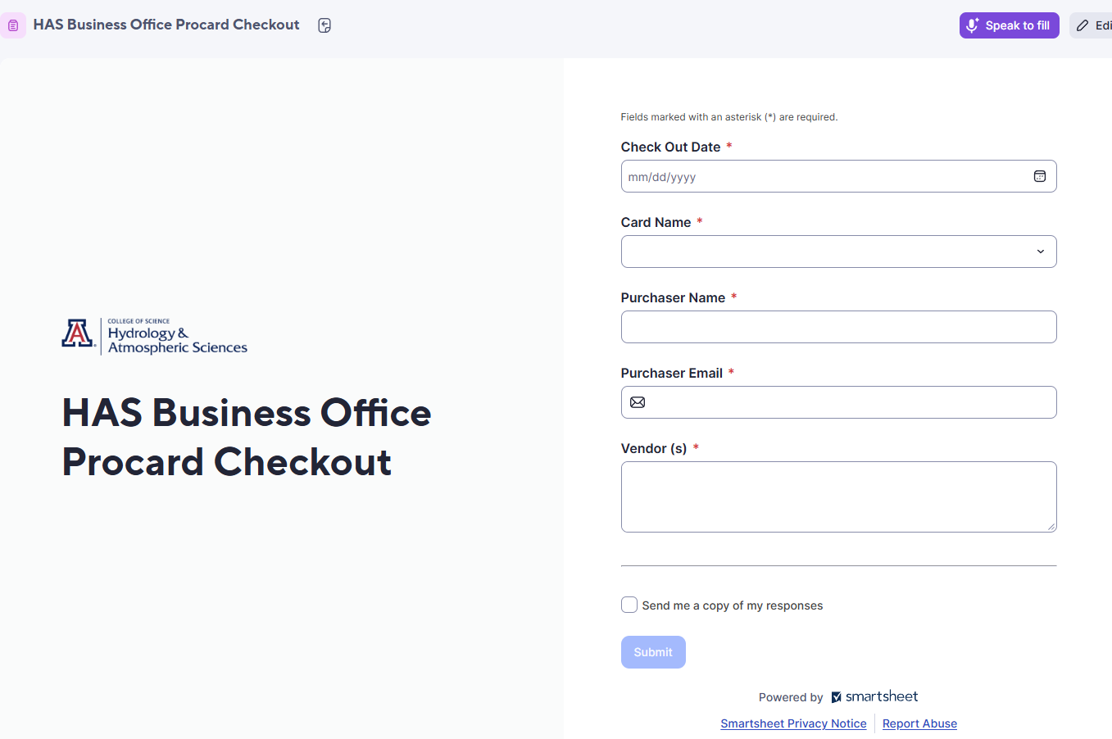
PROCARD CHECKOUT

Slide 5
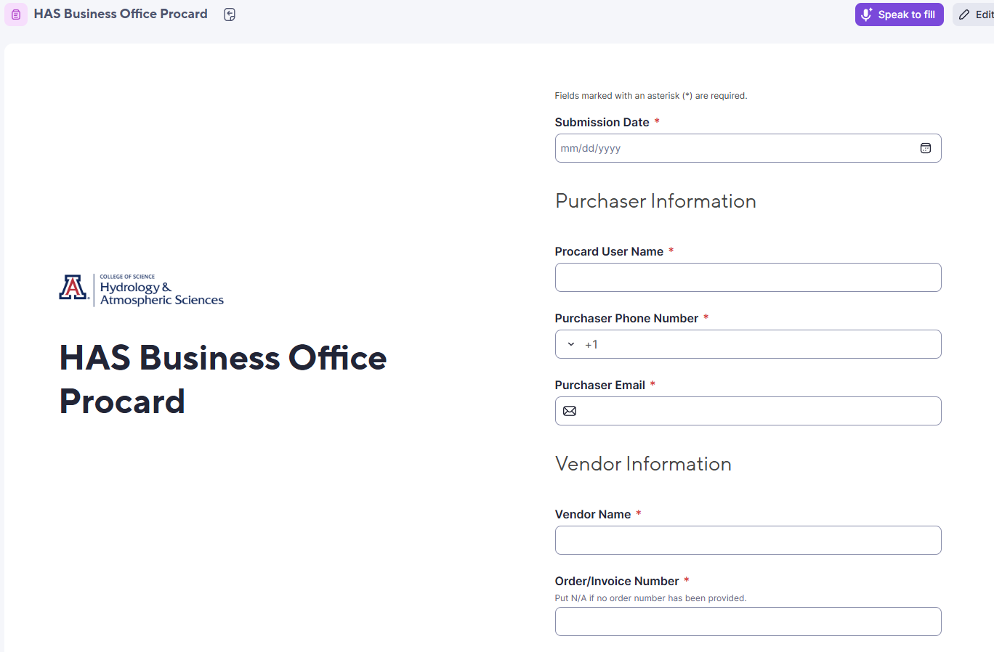
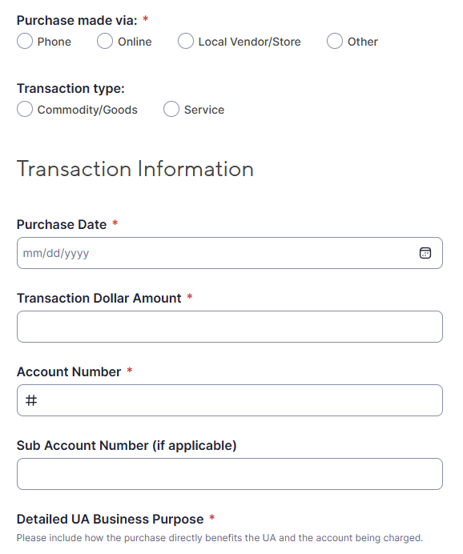
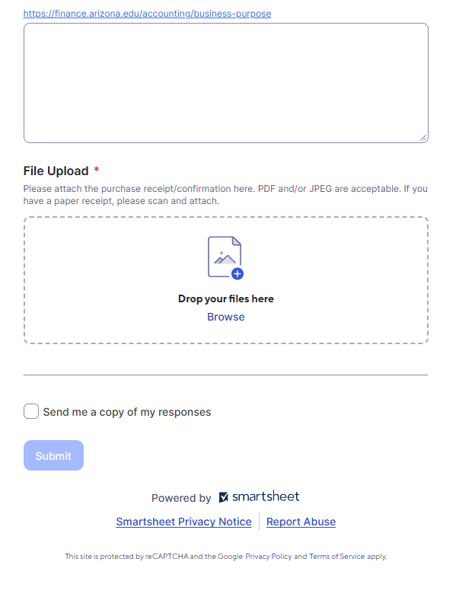
PROCARD
SMARTSHEET
Link for Smartsheet HERE

Slide 6

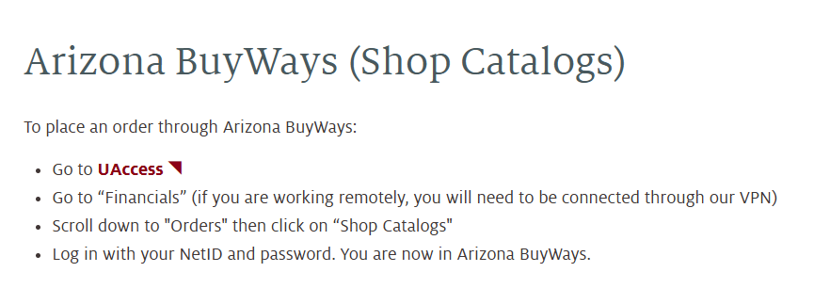
OFFICE SUPPLIES
MUST BE PURCHASED FROM STAPLES USING UA SHOP CATALOGS
INCLUDING ANY PRINTERS, SCANNERS, TONERS
IF STAPLES SELLS IT, IT MUST BE PURCHASED there
YOU CANNOT USE PERSONAL FUNDS AT ANY LOCAL OR ONLINE VENDORS FOR OFFICE SUPPLIES AND SEEK REIMBURSEMENT

Slide 7


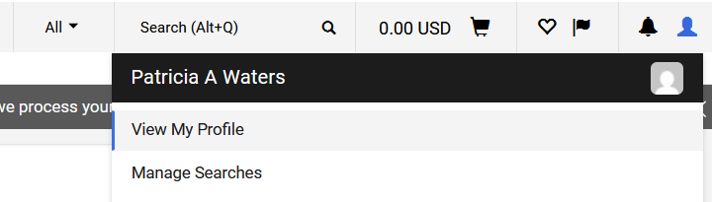
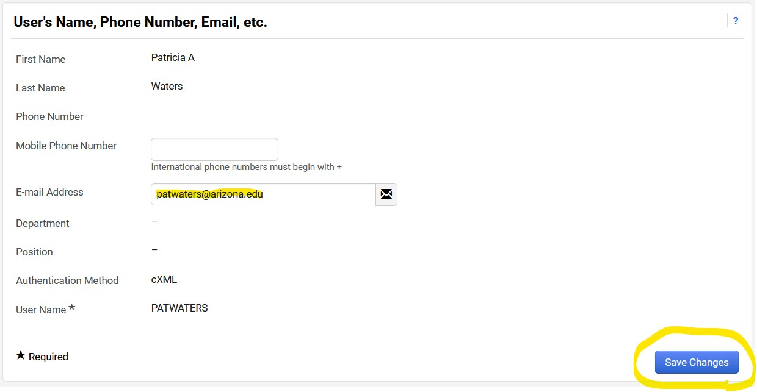
Amazon
MUST BE PURCHASED using UA SHOP CATALOGs, via uaccess, financials, not charged to university or personal card
It is necessary to update your shop catalogs profile with your UA email address to access

Slide 8
TRAVEL REQUESTS
Travel Requests are submitted in Concur, logging on via UAccess
All Students traveling on UA Business must submit a Travel Request
Travel Requests are required if you travel more than 35 miles away from your Duty Post, even if not staying overnight or not claiming any expenses
Travel Requests must be submitted AT LEAST 5 days before travel starts and BEFORE any purchases are made
If any personal travel is included, all costs must be paid out of pocket
International Registry Application should be completed at least 30 days prior
Is this a Blanket Travel Request? – NO Designated Lodging – If conference hotel block
For budgeting purposes, please include ALL expected expenses (Airfare, ground transport, lodging, per diem/travel allowance)
Conference Schedule/ Meeting Agenda / Invite Letter / Itinerary should be attached to Travel Requests
IF CLAIMING PERSONAL VEHICLE MILEAGE, YOU MUST HAVE A CURRENT DEPT AUTHORIZATION FORM ON FILE, COMPLETED DRIVER TRAINING & PROVIDE COPY OF AUTO INSURANCE
TRAVEL REQUEST DEMO VIDEO NOW ON WEBSITE
UNPAID STUDENT TRAVEL PROFILE REQUEST LINK HERE

Slide 9

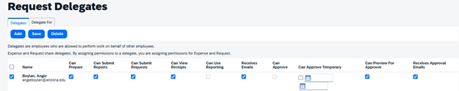
CONCUR PROFILE - DELEGATES
Click your initials at the top right
Next click on Request Settings, then the 2nd option is Request Delegates
Click the delegates tab then Add, type in angieboylan and barnettc and our names will show
Then on the left of our names check the box
Then click all the boxes shown below

Slide 10
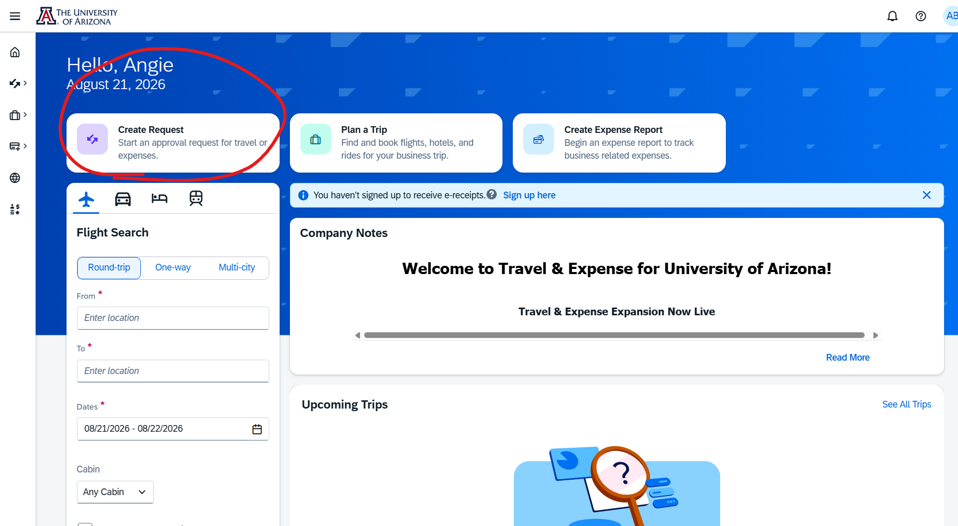
TRAVEL REQUESTS

Slide 11
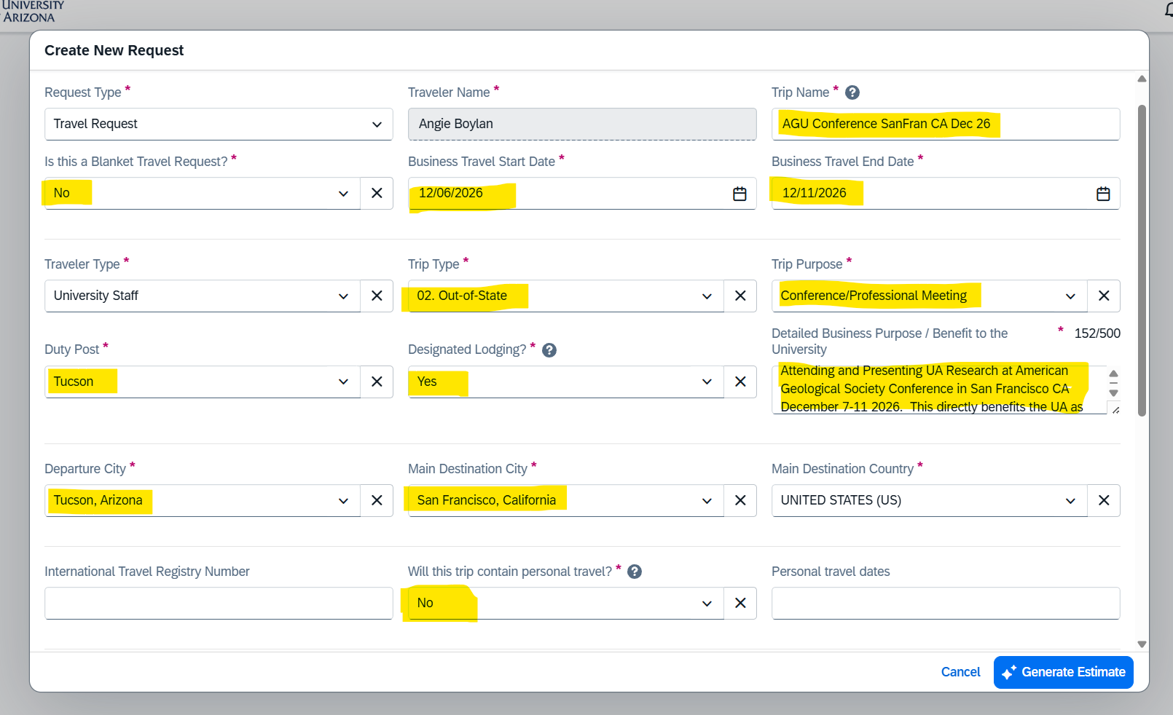
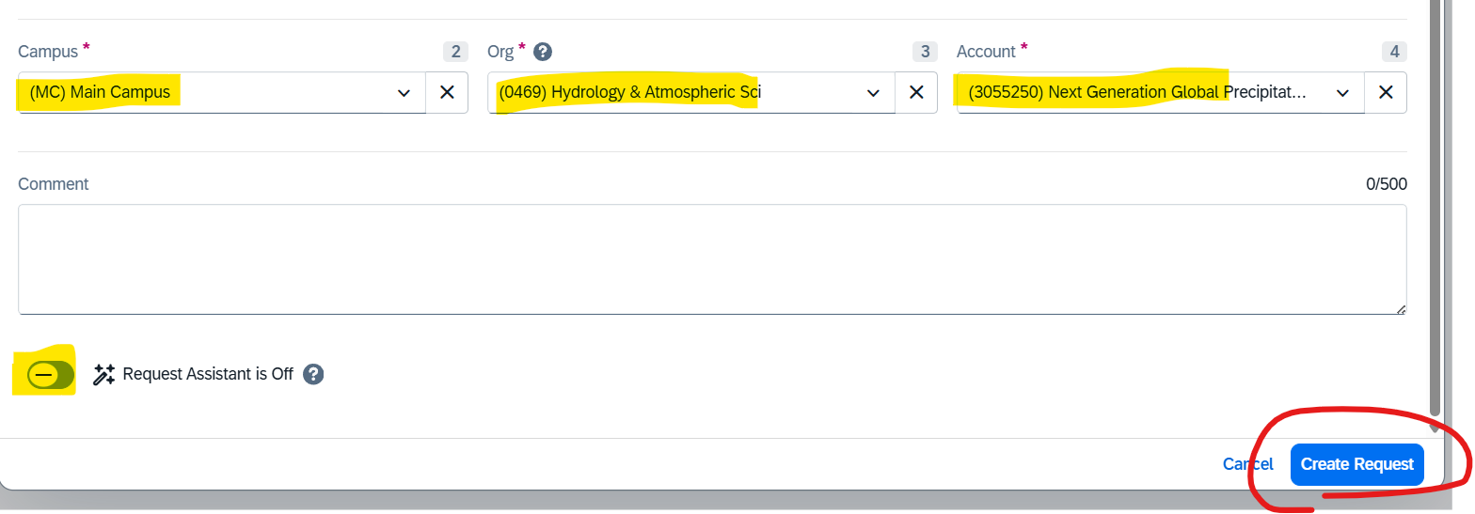
TURN REQUEST ASSISTANT OFF

Slide 12
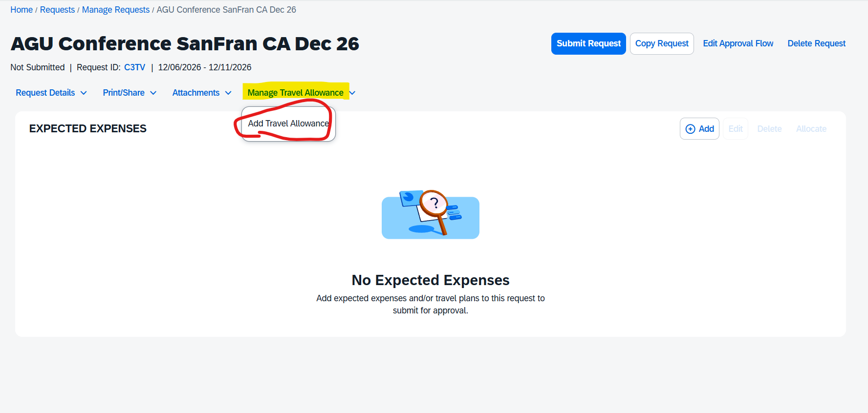
ADD TRAVEL ALLOWANCE (PER DIEM / MEALS)
Meal Travel Allowance: A state‑designated per diem amount available to University of Arizona Travelers for meals and incidental expenses incurred during authorized business travel. These standardized rates streamline administrative processes by removing the requirement to submit individual meal receipts.

Slide 13
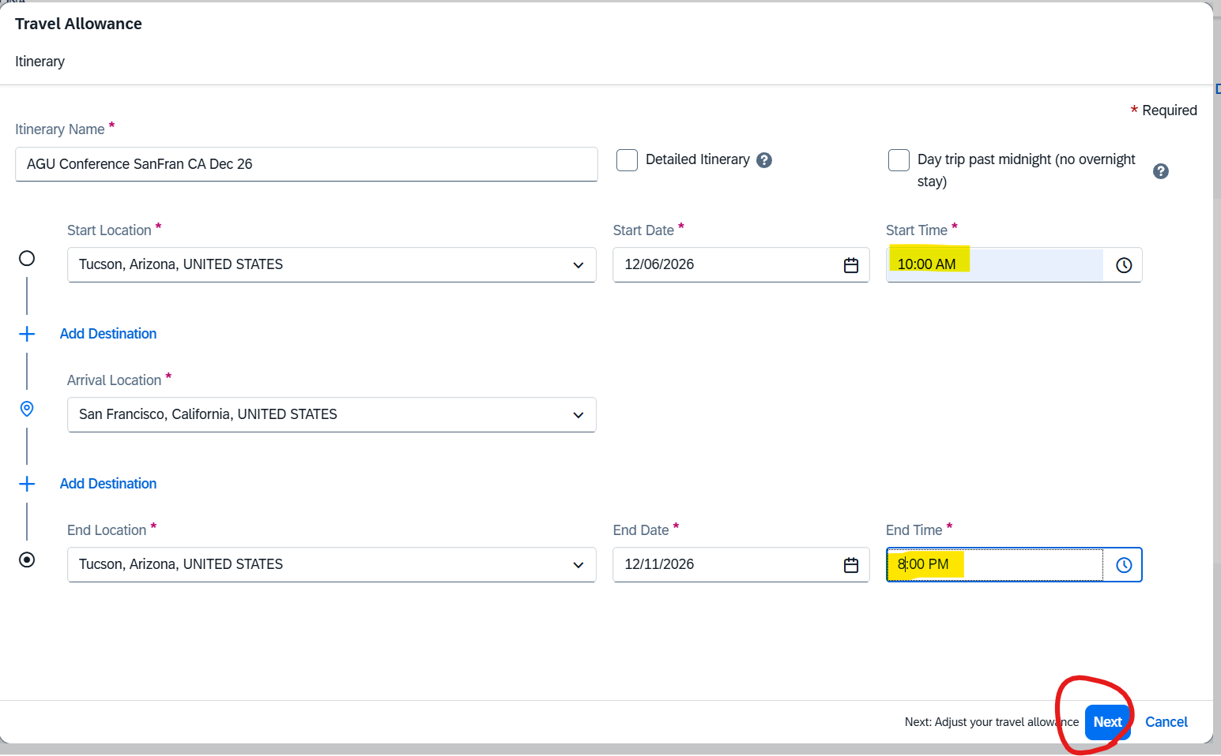

Slide 14
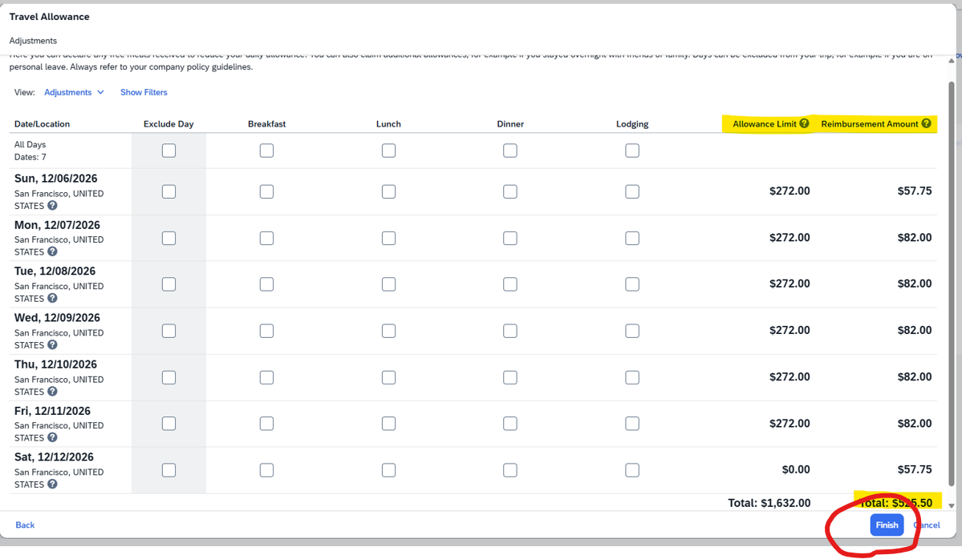
EXCLUDE ANY PROVIDED MEALS OR LODGING

Slide 15
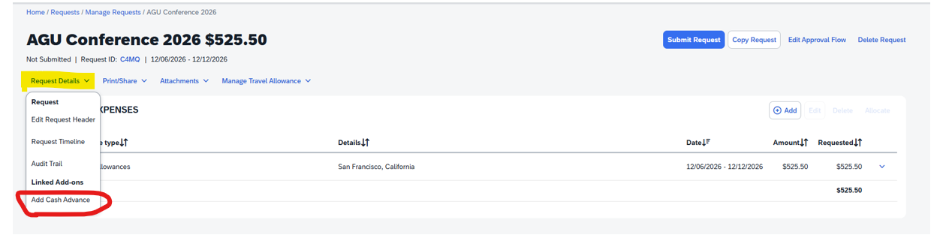
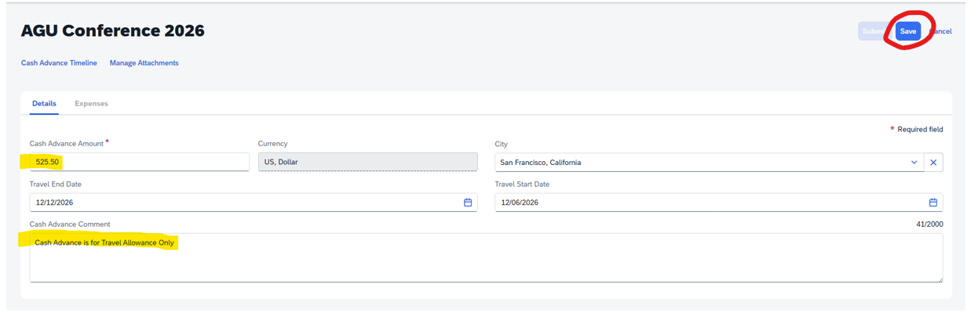
OPTION OF REQUESTING A CASH ADVANCE FOR TRAVEL ALLOWANCE (MEALS) ONLY

Slide 16
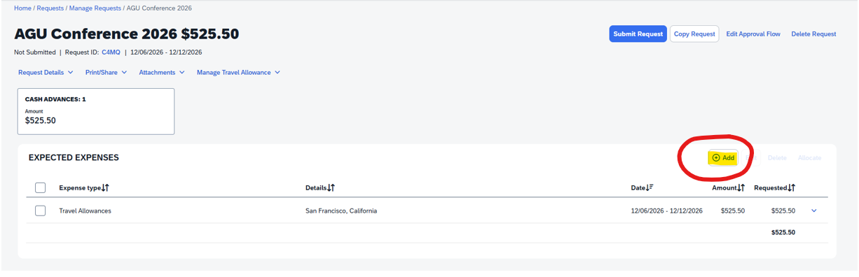
ADD ALL ESTIMATED EXPENSES

Slide 17
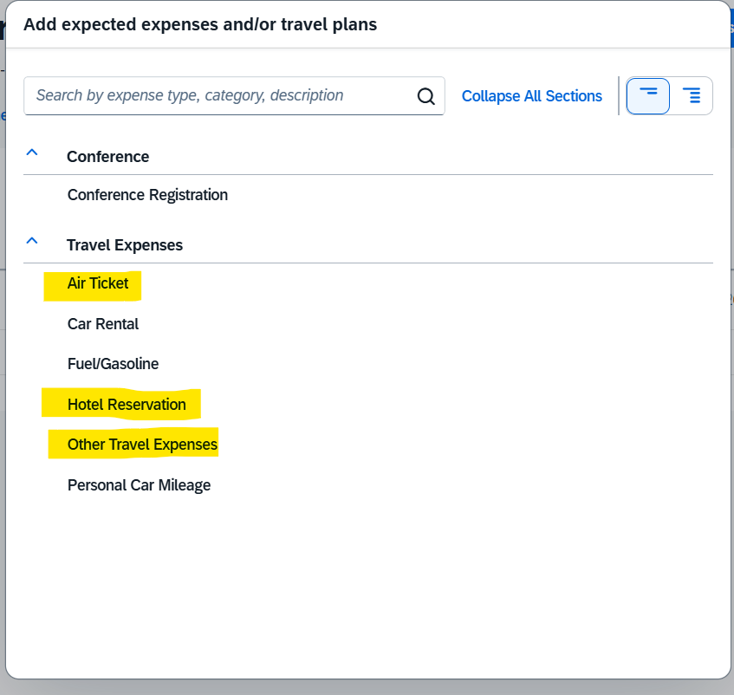

Slide 18
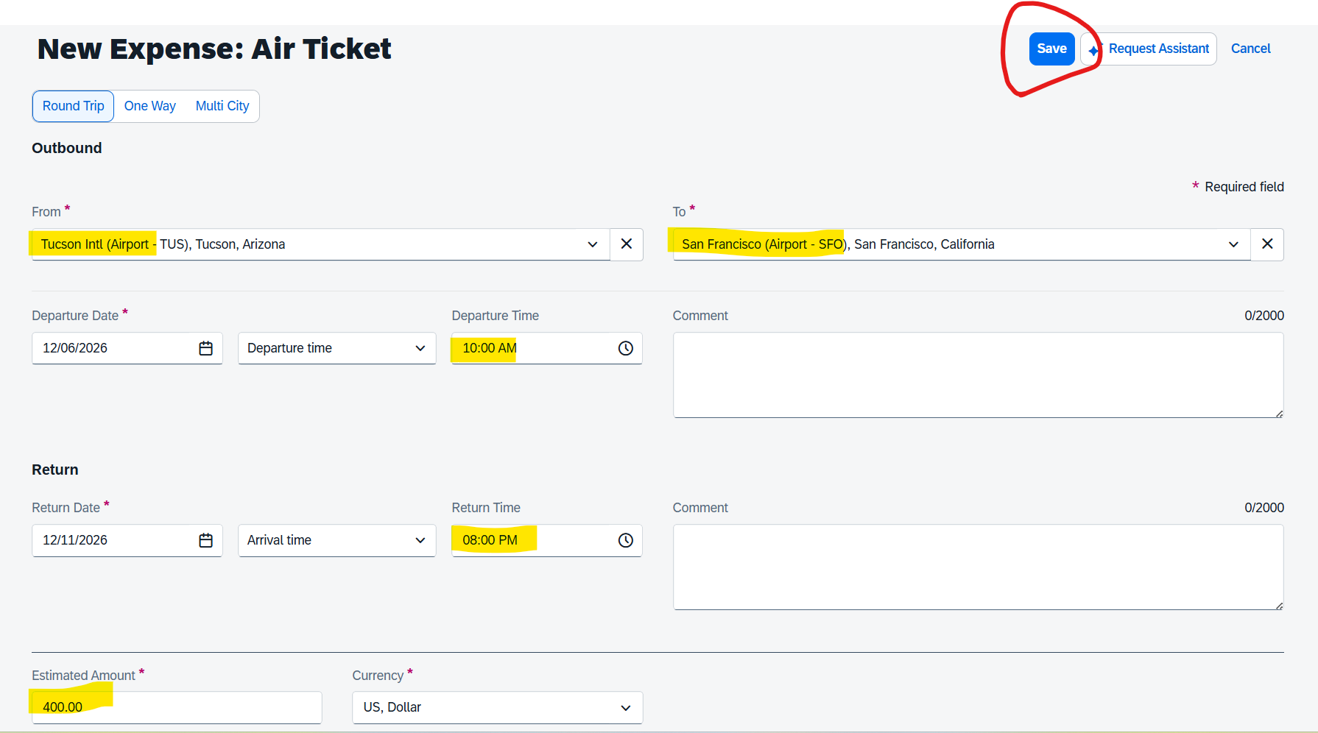

Slide 19
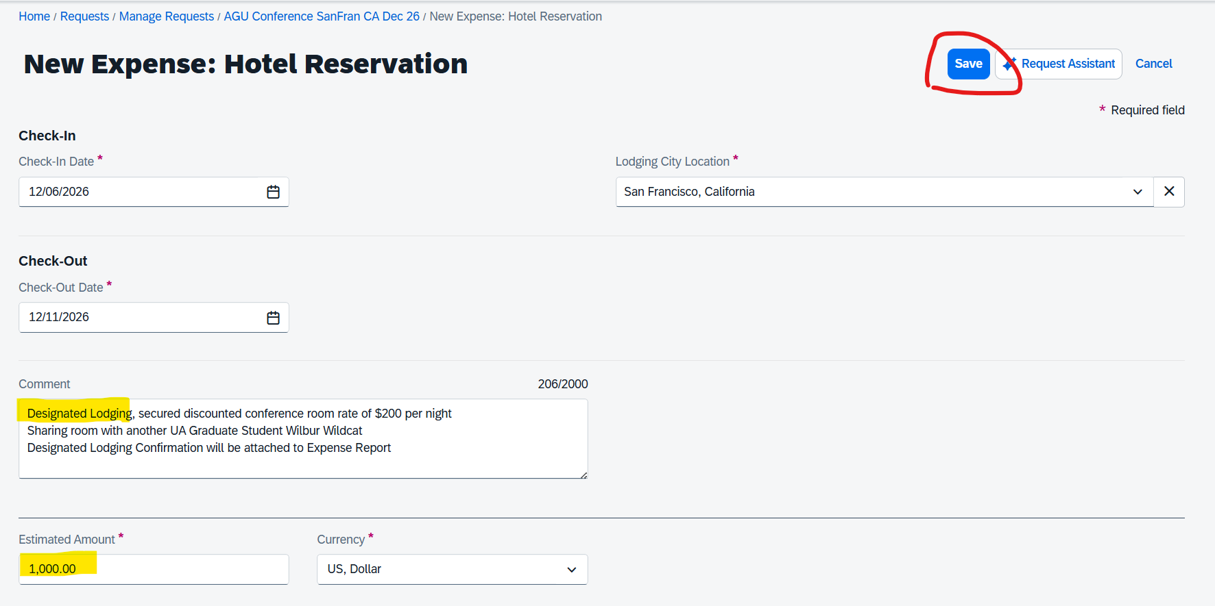

Slide 20
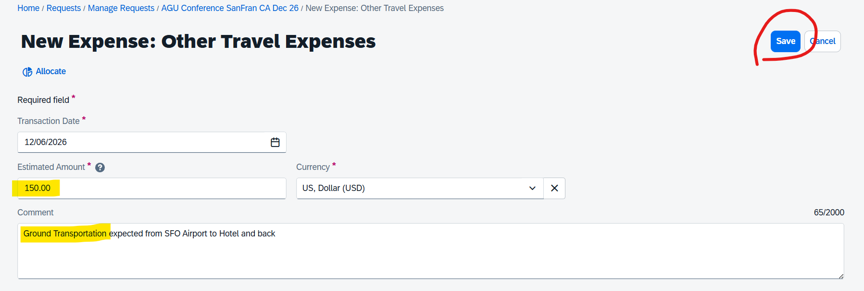

Slide 21
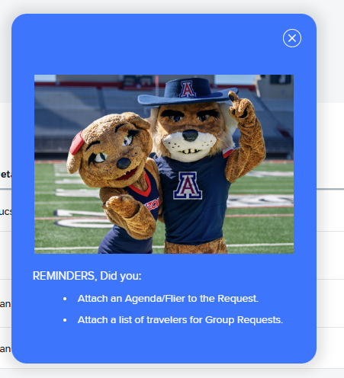
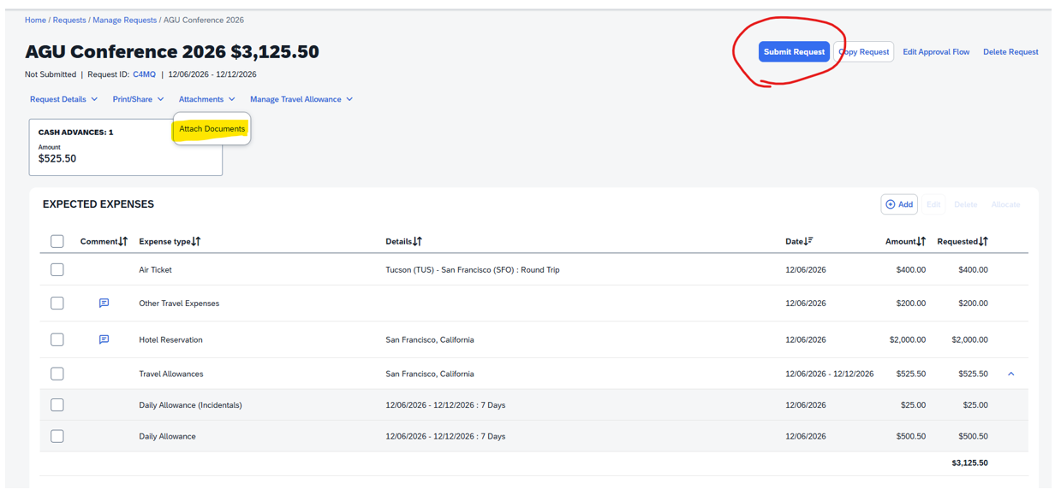
ADD CONFERENCE / MEETING AGENDA OR INVITE LETTER IN ATTACHMENTS

Slide 22
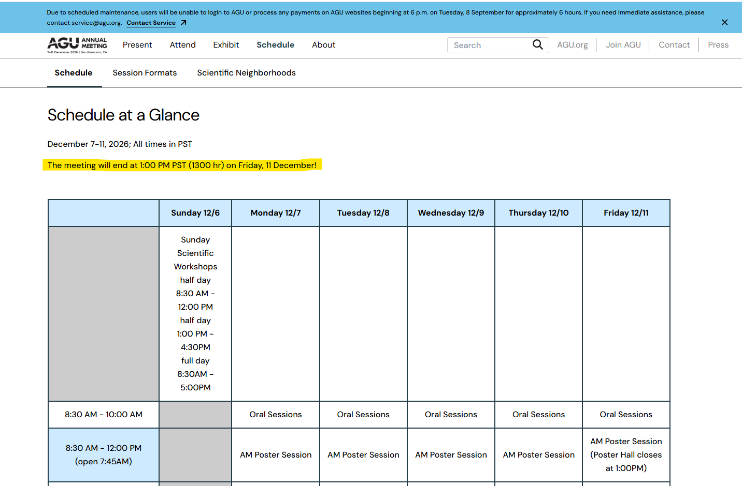

Slide 23





STATE OF ARIZONA ACCOUNTING MANUAL
MAXIMUM REIMBURSABLE RATES FOR LODGING & M&I WITHIN USA
1 Oct.
CO Denver Oct 01 Oct 31 Max Lodging Nightly Rate $215 Max M&I $82
31 Dec.
CA San Francisco Oct 01 Dec 31 Max Lodging Nightly Rate $272 Max M&I $82

Slide 24
STUDENT TRAVEL
Paid students who are required to travel for UA business can only:
Use Anthony Travel booking tool in Concur for airfares
Request accommodation be prepaid using UA virtual card
Request a Cash Advance for M&I costs
OR pay all costs on personal card for reimbursement POST travel
PI’s CANNOT pay for any travel expenses for their students on University Cards (unless a Group Travel Arrangement on OneCard)

Slide 25
LODGING VIRTUAL CARD
If you would prefer to not be out of pocket for lodging expenses and you have no personal travel for your business trip, we can provide a virtual card for your accommodation providing it is designated or does not accept max nightly rates
You will need to request a Quote Folio from hotel and email it to the Business Office with your approved Travel Request information
Virtual card can be requested to use for lodging nightly room rate & taxes only
The card information is provided to the hotel as form of payment, note you will be required to provide personal card for incidentals (if deposit is added to virtual card, it will decline)
The card stays open for up to 60 days post trip so if money can be returned in the event of cancellation or changes

Slide 26
PERSONAL TRAVEL
If you wish to include Personal Travel as part of your UA Business Travel, you –
CANNOT use University Funds for any travel expenses
At time of booking airfare, you need at least two flight comparisons for return airfares for only business appropriate date portion of the airfare
Airfare comparisons should be direct with airlines not 3rd party sellers like Expedia or Booking.com and for similar departure and return times

Slide 27
Commercial Airlines Policy
Airline travel is limited to the cost of the most direct and economical route, ensuring minimal expense to the University.
Economy-class fare or the airline carrier’s equivalent of airline tickets are generally considered the most economical option. Travelers should select airfare that is both economical and reasonable. Comfort-based upgrades for air travel are not permitted with University funds.
An itemized receipt showing the passenger’s name, flight number(s), flight dates, and class of service is required.
The University will only reimburse Travelers for out‑of‑pocket expenses; vouchers, promotion, credits discounts, mileage earned, or rewards used at no cost to the Traveler are not eligible for reimbursement
Non-economy fare is allowed only when the Traveler has a documented medical need on file with the (DRC) that requires an upgrade. In all other instances, the following applies to single flights (individual legs or segments):
  For single flights under six continuous hours, Travelers may only select economy class or main cabin fares that allow standard seat selection without an upgraded seating class or additional premium travel benefits. Travelers must choose the most direct and economical option available.
  For single flights between six and 10 continuous hours, employees may upgrade to economy plus or equivalent categories (e.g., extra legroom, preferred seating).
  For single flights over 10 continuous hours, employees may upgrade to business class with written approval from their college dean or division senior leader. The written approval must document the business purpose for the upgrade and be attached to the Travel Request. Senior leaders must receive approval from their immediate supervisor.
  Additional considerations: When requesting an upgrade for flights of six continuous hours or longer, additional travel logistics may be required, such as booking individual travel segments at different class categories.
If a Traveler chooses to purchase a higher class airfare, the excess cost is considered a personal expense and is not allowable on University funds or eligible for reimbursement. To determine the reimbursable portion, the Traveler should provide documentation from the time of booking showing the lowest economy-class fare available for the most direct and economical route that would have met the Traveler’s scheduling needs and the business purpose of the trip. The Traveler is responsible for paying for a higher-class fare with personal funds and may seek reimbursement only for the business appropriate portion of the airfare (i.e., the equivalent economy‑class fare) through the Travel Expense Report after completion of the trip.
The use of personal frequent flyer miles, points, or vouchers for University business travel may not be claimed by the Traveler as a reimbursable expense.
Use of federal or sponsored funds must always comply with both University and sponsor-specific policy.
When federally sponsored funds will be utilized for travel, refer to the "Fly America Act," which requires Travelers to use U.S. flag air carriers regardless of costs or convenience.

Slide 28
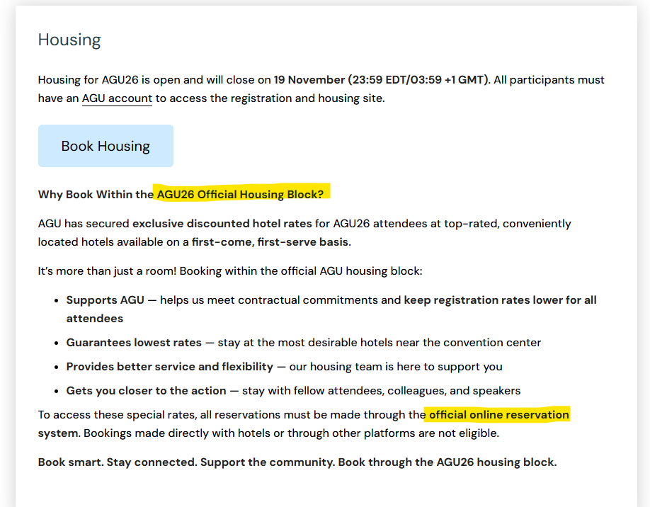
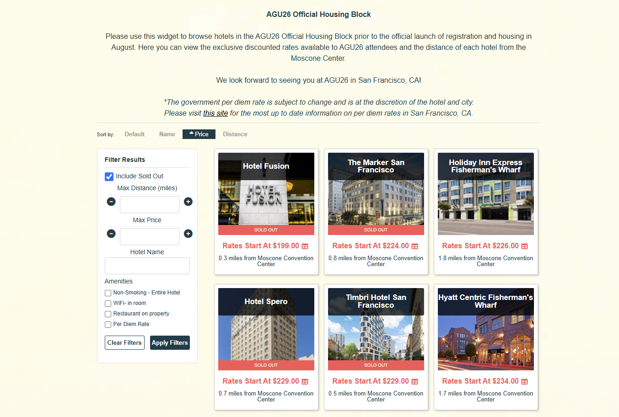
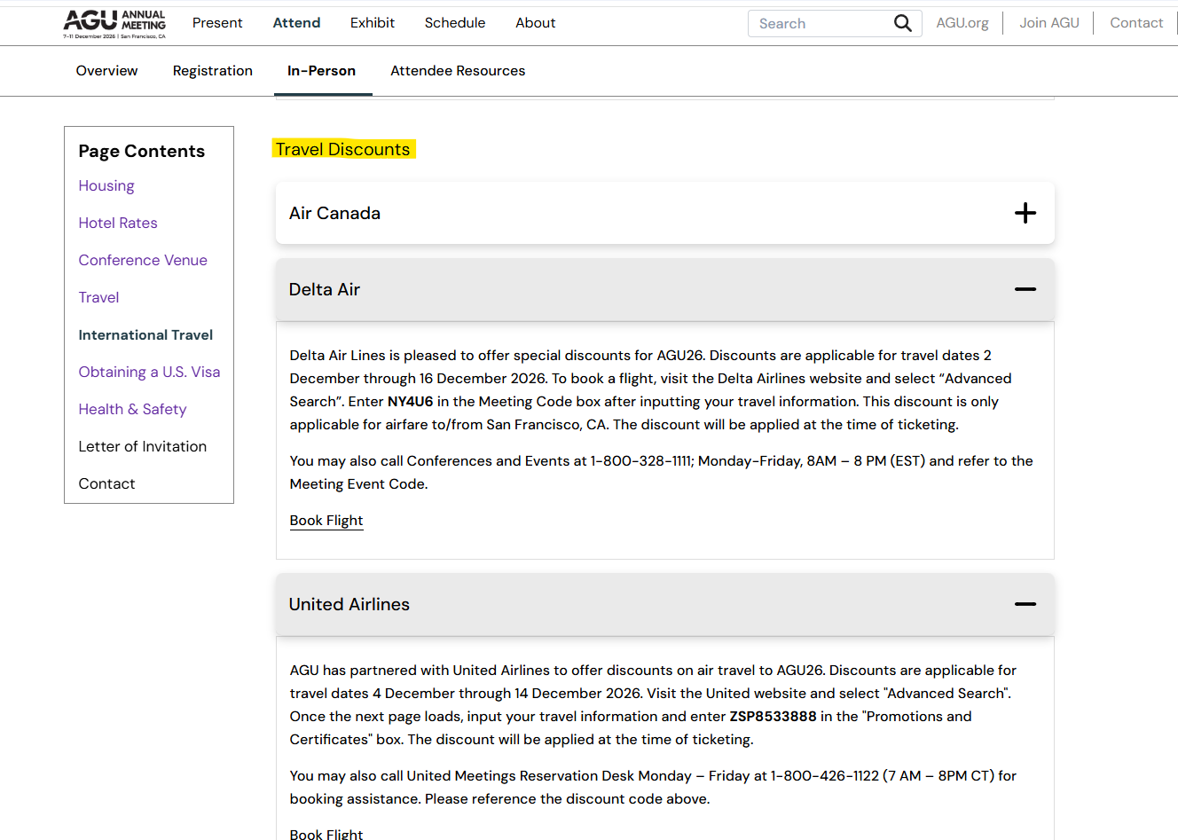
DESIGNATED LODGING

Slide 29
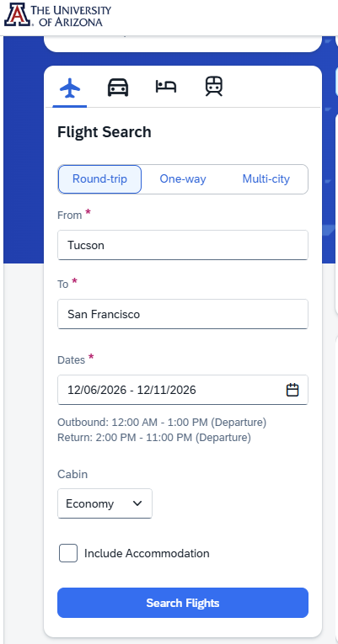
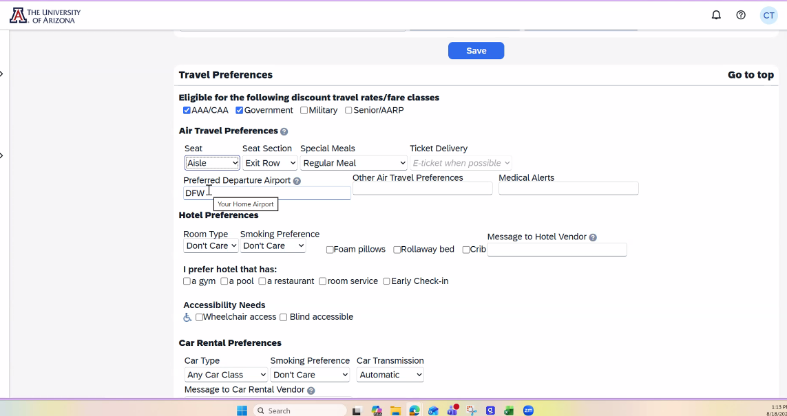
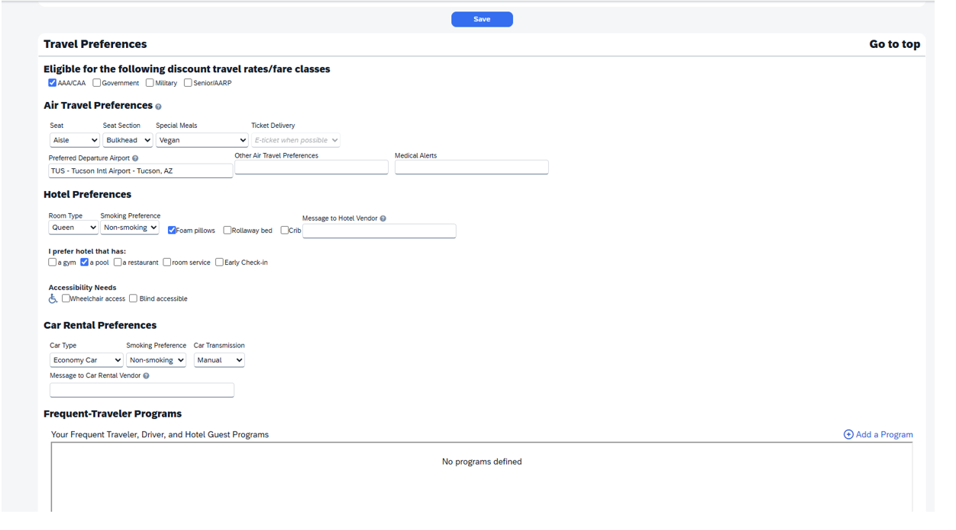
Concur Booking Tool – Anthony Travel
Use for Airfare only, not lodging or rental vehicles
Using the Booking Tool incurs a $3 agent fee for any ticketed airfare
Cannot be used if personal travel is included
Profile Name must match your Passport / Traveler Name
Ensure your cell number is on your profile
Include preferences and airline member / advantage numbers, TSA PreCheck, Known Traveler Number etc on travel profile
WATCH DEMO
HERE

Slide 30
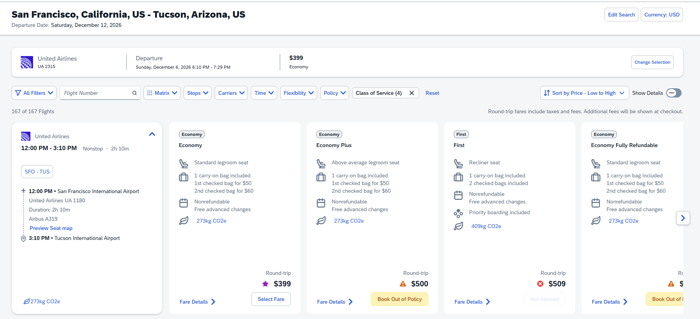

Slide 31
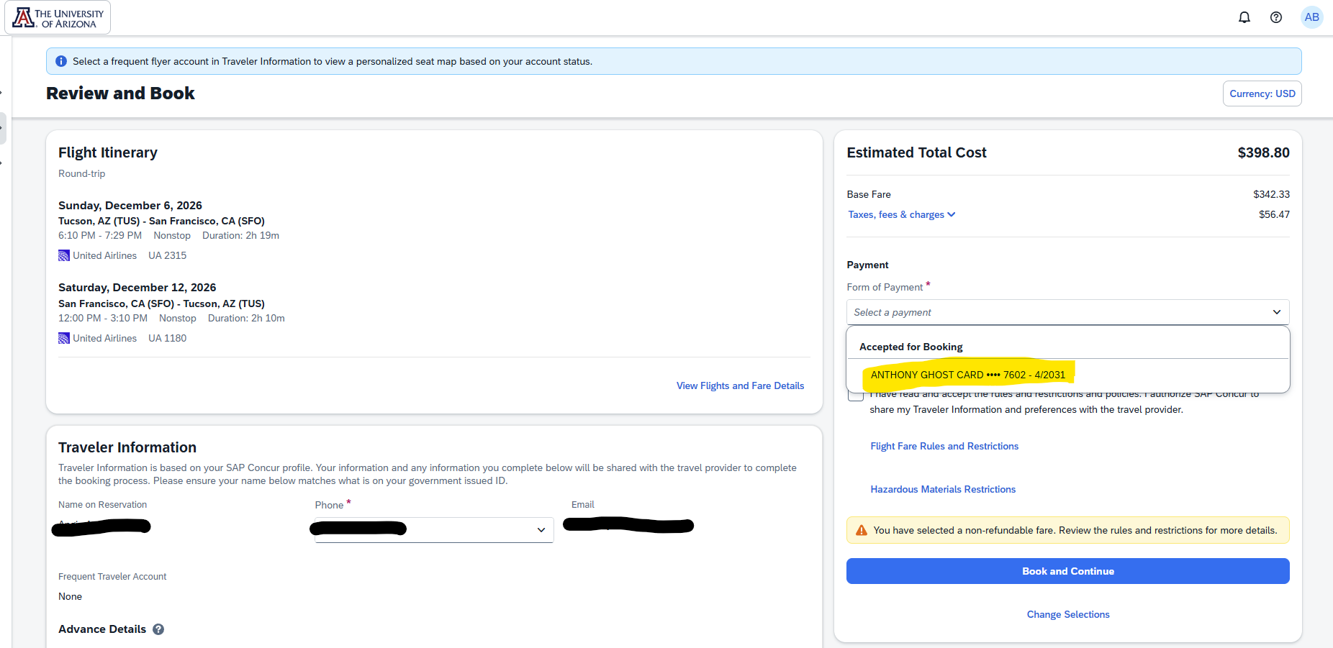

Slide 32
REMINDERS
Business Purposes must be detailed – Include WHO, WHAT, WHERE, WHEN, WHY & HOW it benefits the University and/or the Account expensed
Per Diem is now referred to Travel Allowance and it broken out into a Daily Allowance amount & $5 of Incidentals
For ‘Designated Lodging’ on your trip, please include attachment to verify
If Tucson is your Base location, you must fly out of TUS, unless detailed justification AND flight comparisons, including any travel and parking costs are provided

Slide 33


