Slide 1


Concur travel & expense updates
HAS FACULTY PRESENTATION – Business office

Slide 2
No more PCards – If you still have a PCard,
please return to the Business Office or safely destroy it!
New University Card Options –
TravelCard, OneCard & ProCard
To request a University Card, you need to first complete
the training before submitting a Card Request through Concur.
Reimbursement of out-of-pocket expenses is limited to qualified and approved travel expenditures incurred while conducting University business that could not reasonably be paid using a University payment method.

Slide 3
PROCARD
Currently only 1 in the Department, held by Cindy Barnett
Available for use by HAS Employees for operational expenses (less than $10K)
If you don’t have your own University Card – this is the card to use for your non-travel purchases
This card CANNOT be used for any travel purchases

Slide 4
TRAVELCARD
This card CANNOT be used for any travel purchases for employees other than the cardholder
Designed for employees who travel at least once per year and make travel purchases for themselves only
Able to make infrequent non-travel purchases without exceeding card limits
Should not be used for frequent/ongoing non-travel purchases

Slide 5
ONECARD
This card CANNOT be used for any travel purchases for employees other than the cardholder
Designed for employees who travel at least once per year and make travel purchases for themselves, group/field trip & non- employee travel, including employee/student recruitment
Able to make infrequent non-travel purchases without exceeding card limits

Slide 6
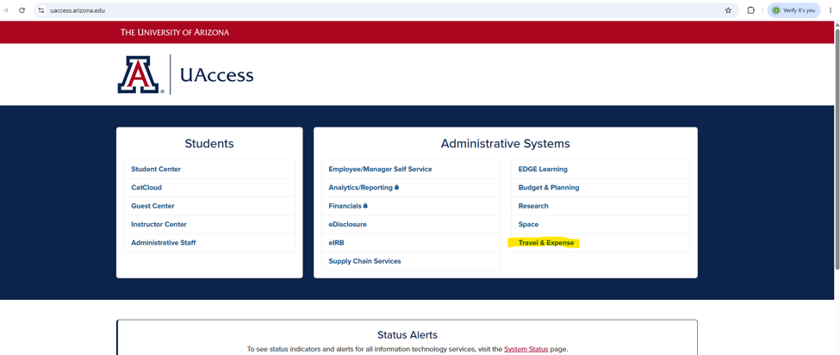
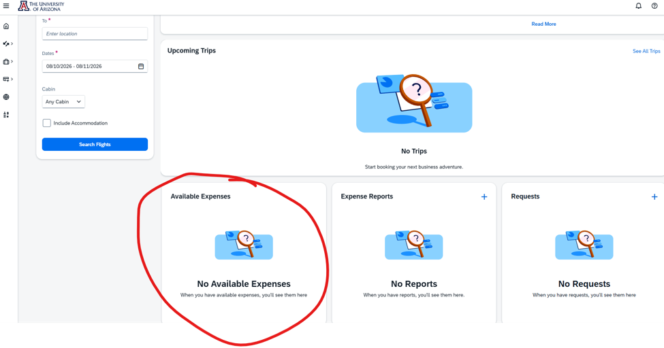
CARD CHARGES
University Card Charges will appear in Concur under Available Expenses and email notification will be received
FSO request no more than 2 expense reports submitted per month
Multiple purchases can be submitted on one report

Slide 7
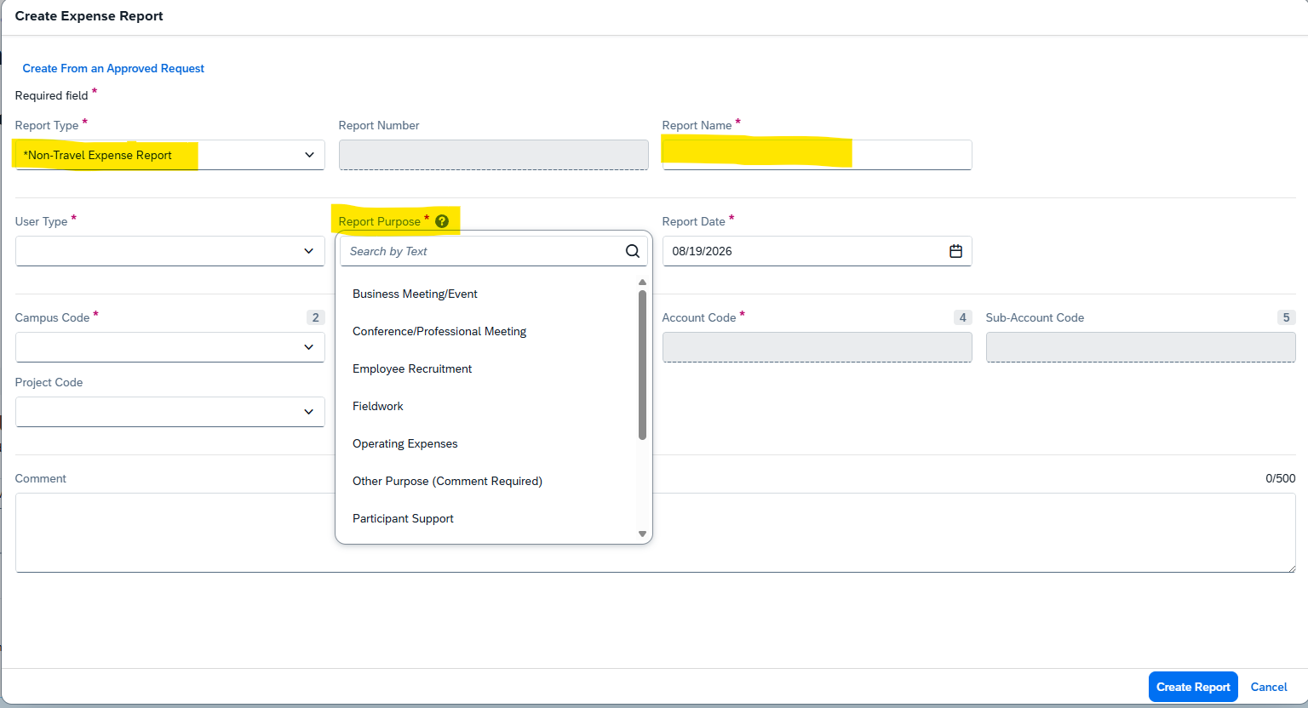
CARD CHARGES
If charge does not relate to travel (eg Publication Fee, Abstract/Registration Fee, Subscription, Membership Dues) you select “Non-Travel Expense Report”
IF YOUR ACCOUNT CODE IS NOT FOUND IN THE ACCOUNT CODE BOX - PLEASE CONTACT THE BUSINESS OFFICE!
IF YOU HAVE A SUB ACCOUNT, ENSURE IT IS ADDED, DON’T JUST INCLUDE A NOTE IN THE COMMENTS

Slide 8
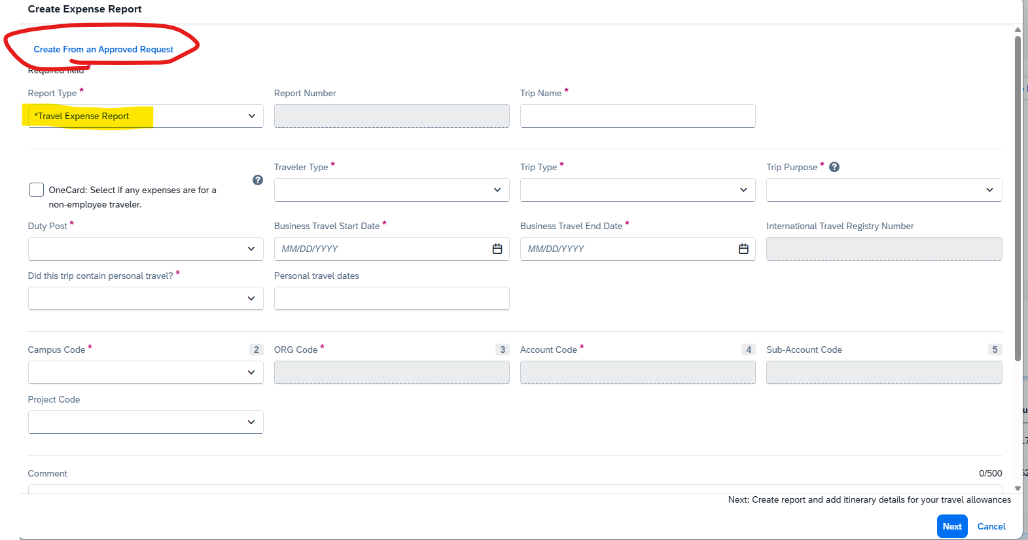
CARD CHARGES
If charge does relate to travel (eg Airfare), you would select a “Travel Expense Report” and click “Create from an Approved Request”
FSO request Travel Expense Report to be completed within 10 days AFTER trip
PLEASE SCHEDULE A ZOOM OR IN PERSON MEETING WITH THE BUSINESS OFFICE TO RECEIVE ASSISTANCE WITH YOUR FIRST OR ANY EXPENSE REPORT
CONFIRMING ACCURACY LIMITS DELAYS IN PAYMENT!

Slide 9
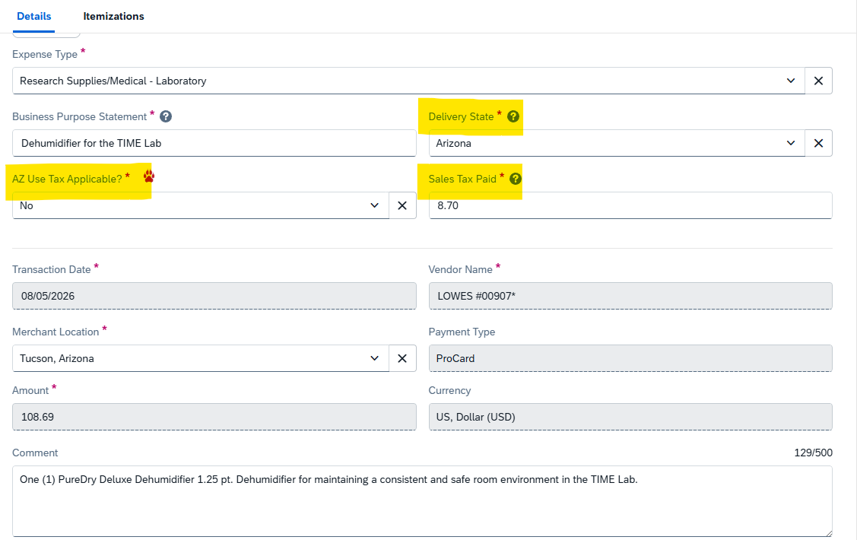


REMEMBER - IF SALES TAX IS PAID, USE TAX IS NOT APPLICABLE
IF SALES TAX IS NOT CHARGED, USE TAX IS APPLICABLE
THE CHARGES WHEN
SALES TAX AND USE TAX ARE
NOT APPLICABLE (TAX EXEMPT)
INCLUDE:
CONFERENCE ABSTRACT & REGISTRATION FEES
MEMBERSHIP DUES
AIRFARES
SERVICES

Slide 10
COMMON EXPENSE TYPES
3125 Cloud Services – Storage, Network, Software Resources provided by off campus external vendors (eg Slack, Garmin)
3990 Communications – (eg Chat GPT Subscriptions)
4210 Misc Research Services – (eg External lab services)
4620 Software Licenses – (eg Data processing software – CANNOT be purchased from Foreign Vendor)
4690 Permits / Camping Fees
4840 Printing & Lithography – (eg Poster Printing for conference presentations)
4860 Journal Printing / Publication Fees
5150 PC Related Costs
5175 Business Meals – (eg Meals / Refreshments in connection with business meetings, interviews or events, must include attendee list and agenda)
5180 Educational Supplies
5290 Lab Supplies / Research
5520 Conference Registration Fees
5535 Credit Card Surcharges (CC charges require separating in the Itemizations tab)
5540 Membership Dues
5560 Freight – Any shipping/handling fees (Shipping/Freight charges require separating in the Itemizations tab)
5722 Non-Cap Asset for Grant Accounts – (eg computers)
5760 Non-Cap Equip for Non Grant Accounts – (eg Hard Drives, EDP)
5775 Non-Cap Furnishings – (eg Tables, Office Chairs)
5780 Misc Operating – (eg Conference Abstract Fees, Permits, Visa Fees)
5890 Books Departmental

Slide 11


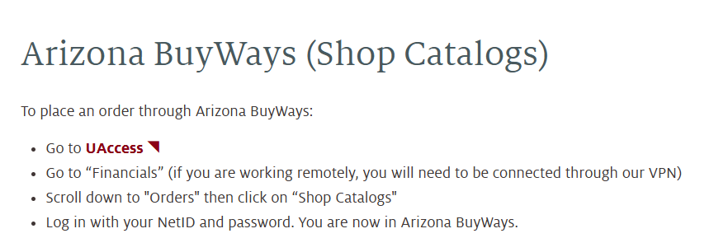
OFFICE SUPPLIES
MUST BE PURCHASED FROM STAPLES USING UA SHOP CATALOGS
INCLUDING ANY PRINTERS, SCANNERS, TONERS
IF STAPLES SELLS IT, IT MUST BE PURCHASED THERE
YOU CANNOT USE YOUR UNIVERSITY CARD AT ANY LOCAL OR ONLINE VENDORS FOR OFFICE SUPPLIES OR USE PERSONAL FUNDS AND SEEK REIMBURSEMENT

Slide 12


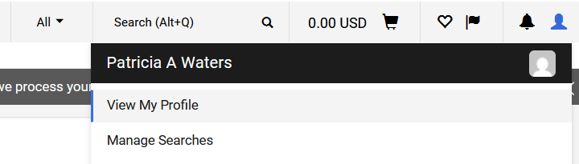
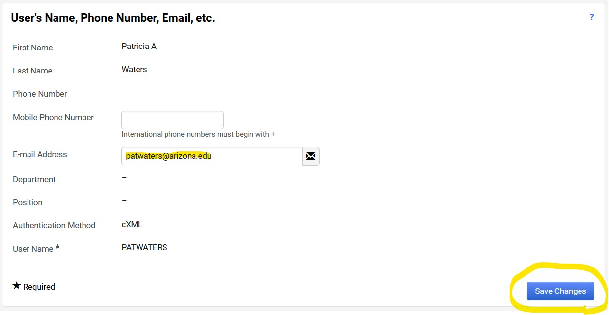
Amazon
MUST BE PURCHASED using UA SHOP CATALOGs, via uaccess, financials, not charged to personal or university card
It is necessary to update your shop catalogs profile with your UA email address to access

Slide 13


FOREIGN SOFTWARE
THE UNIVERSITY RESTRICTS PAYMENT TO FOREIGN ENTITIES OR INDIVIDUALS FOR SERVICES AND SOFTWARE
FOREIGN SOFTWARE CAN ONLY BE PURCHASED BY USE OF A VIRTUAL CARD PAYMENT
PLEASE SEE BUSINESS OFFICE IF FOREIGN SOFTWARE PURCHASE IS REQUIRED

Slide 14
CAPITAL PURCHASES >$5K
A capital item is a single item with a list price of $5K or more.
It is NO LONGER ALLOWABLE to make a capital purchase of a single item over $5K (now a violation)
Must now be routed via a Purchase Order request
Need to obtain a quote from the vendor and route a PO request Smartsheet

Slide 15
TRAVEL REQUESTS
Travel Requests are submitted in Concur, by logging on via UAccess
All Students (regardless if being paid) traveling on UA Business must submit Travel Request
Travel Requests are required if you travel any distance away from your Duty Post, even if you are not staying overnight, but plan on being reimbursed for expenses
Travel Requests must be submitted AT LEAST 5 days before travel starts and BEFORE any purchases are made
International Registry Application should be completed at least 30 days prior
Is this a Blanket Request? - NO
For budgeting purposes, please include ALL expected expenses (Airfare, ground transport, lodging) Include per diem/travel allowance estimates
Conference Schedule/ Meeting Agenda / Invite Letter / Itinerary should be attached to Travel Requests
IF CLAIMING PERSONAL VEHICLE MILEAGE, YOU MUST HAVE A CURRENT DEPT AUTHORIZATION FORM ON FILE, COMPLETED DRIVER TRAINING & PROVIDE COPY OF AUTO INSURANCE
TRAVEL REQUEST DEMO VIDEO NOW ON WEBSITE
Unpaid Student Travel Profile Request Link HERE

Slide 16
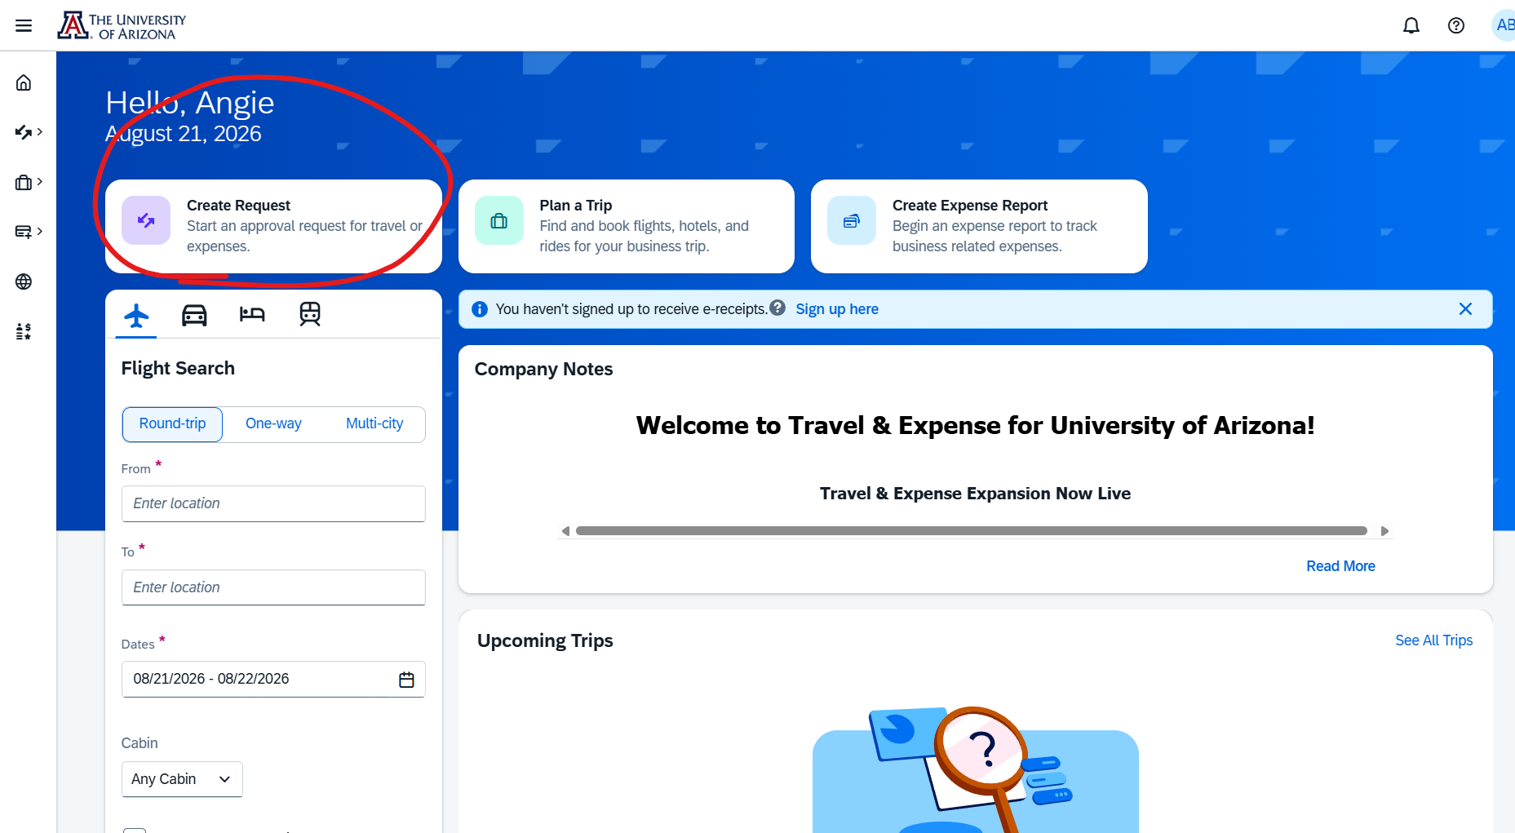
TRAVEL REQUESTS

Slide 17
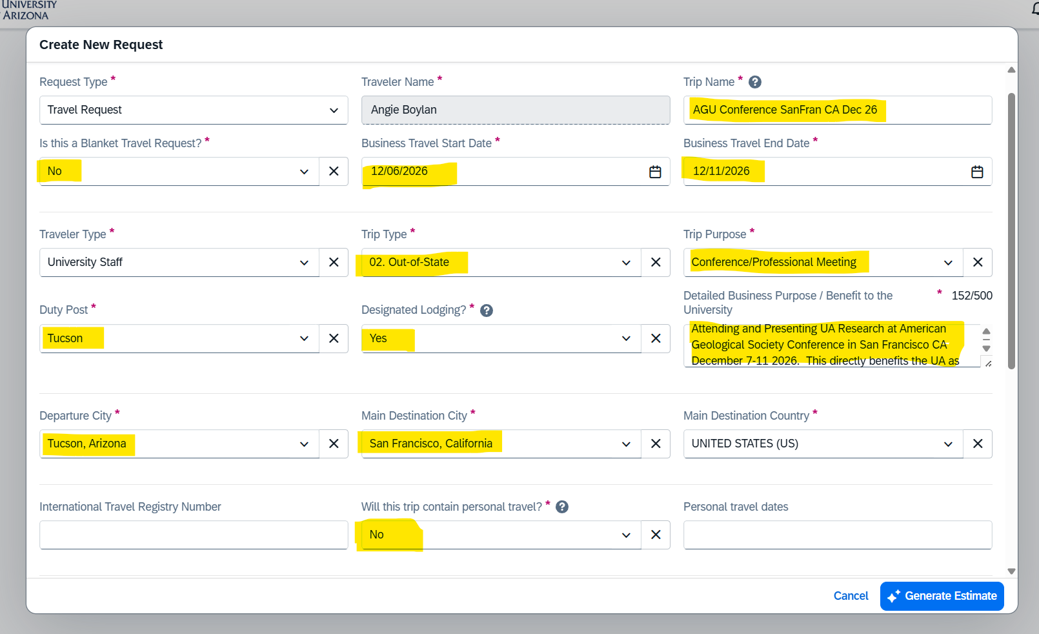
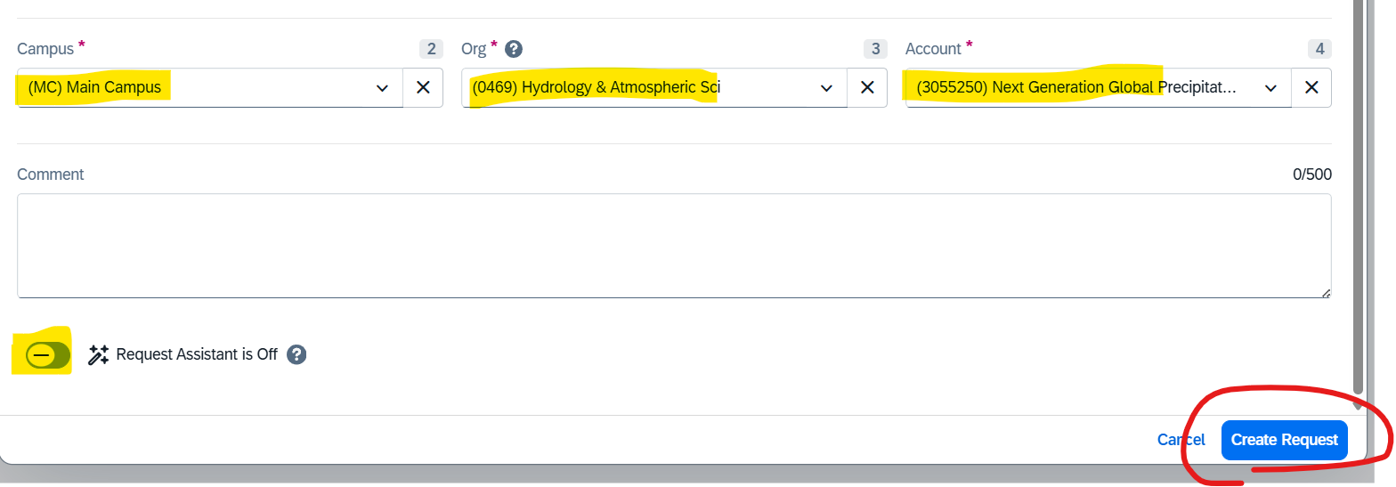
TURN REQUEST ASSISTANT OFF

Slide 18
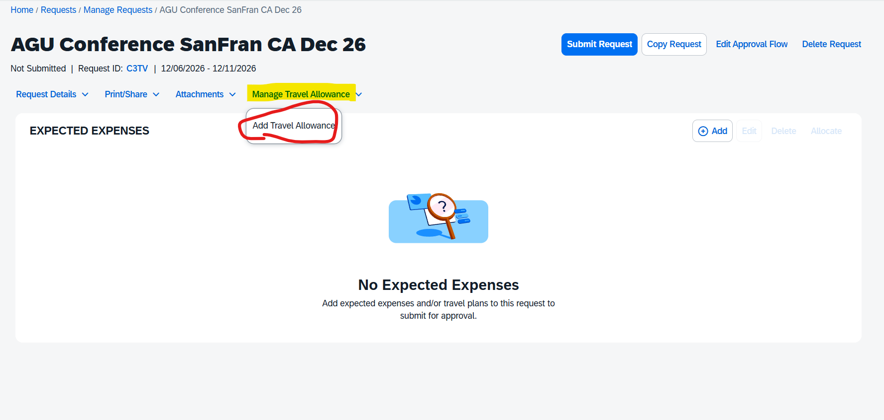
ADD TRAVEL ALLOWANCE (PER DIEM / MEALS)
Meal Travel Allowance: A state‑designated per diem amount available to University of Arizona Travelers for meals and incidental expenses incurred during authorized business travel. These standardized rates streamline administrative processes by removing the requirement to submit individual meal receipts.

Slide 19
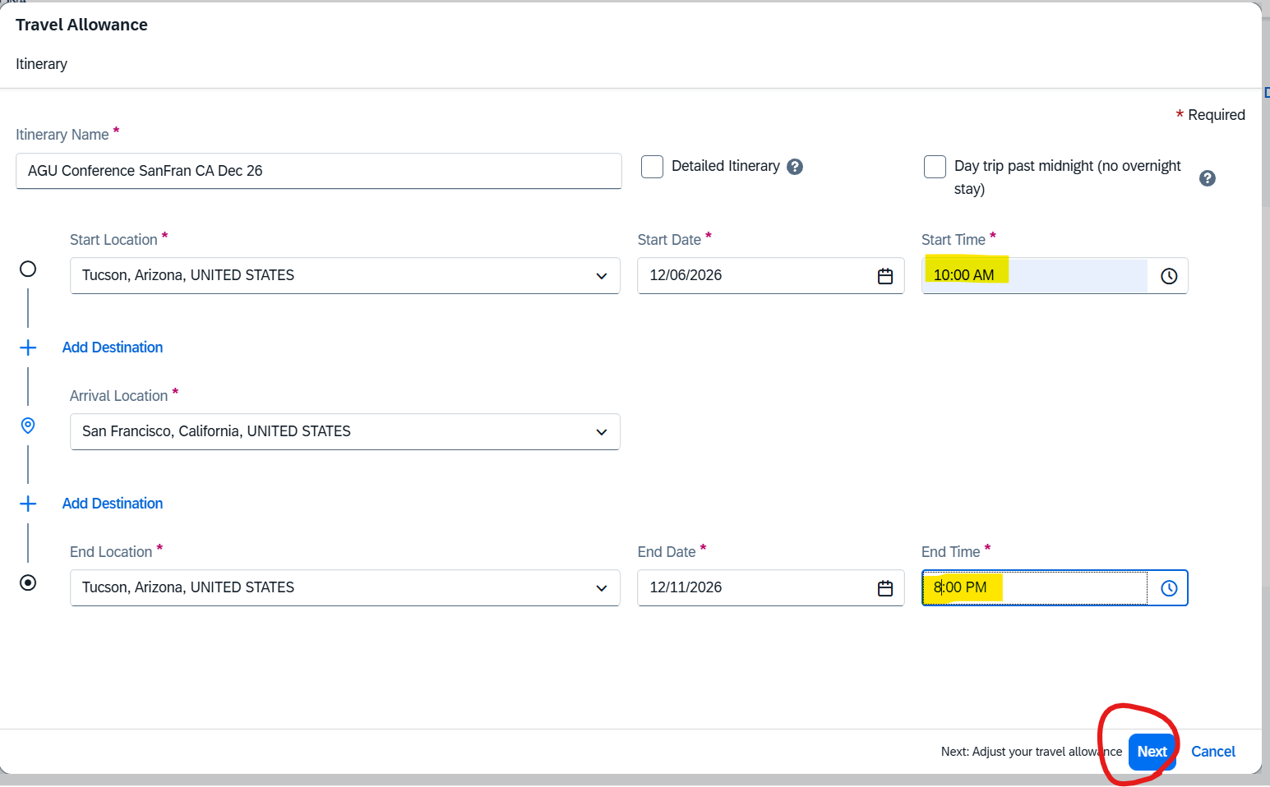

Slide 20
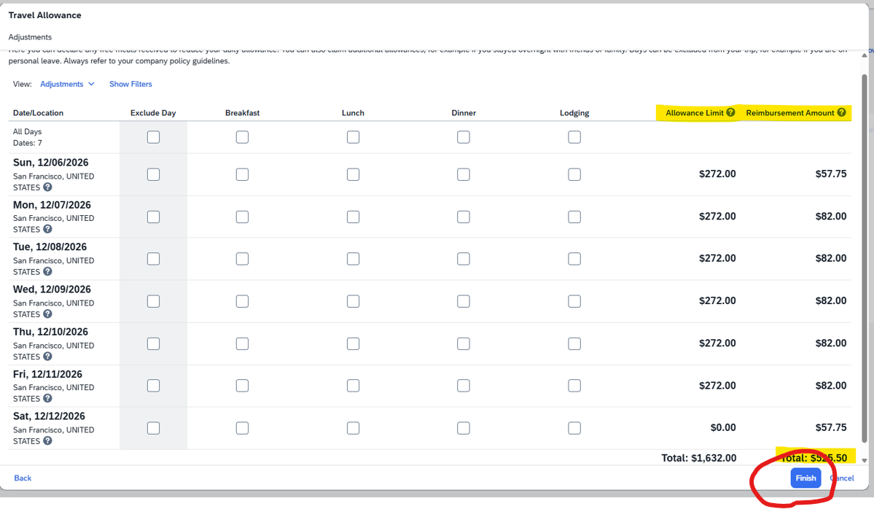
EXCLUDE ANY PROVIDED MEALS OR LODGING

Slide 21
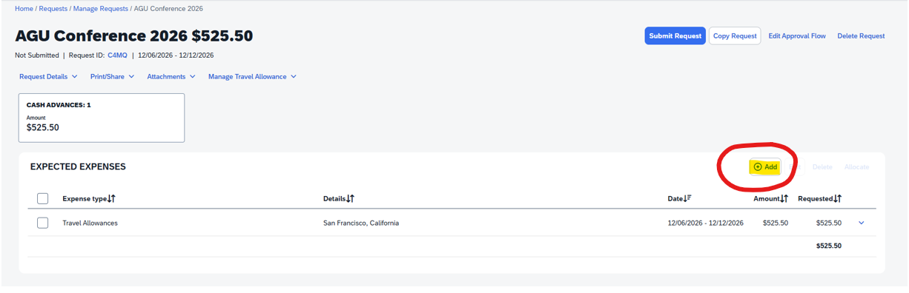
ADD ALL ESTIMATED EXPENSES

Slide 22
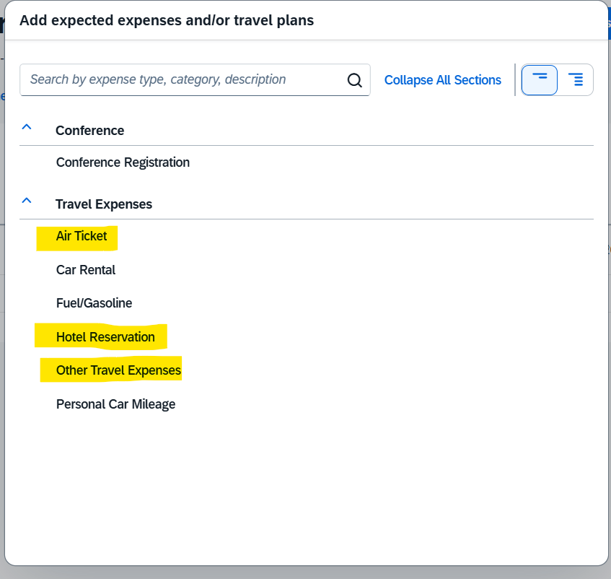

Slide 23
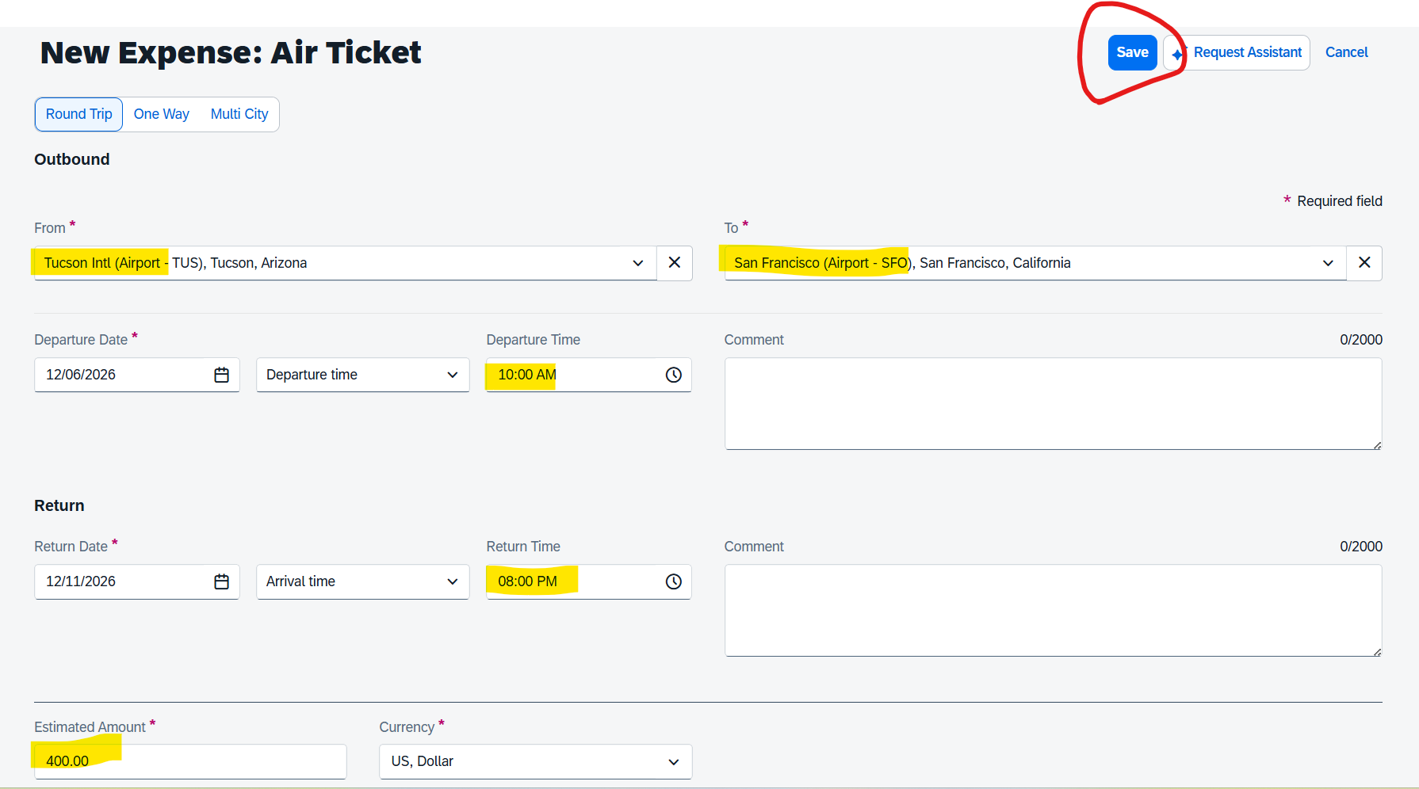

Slide 24
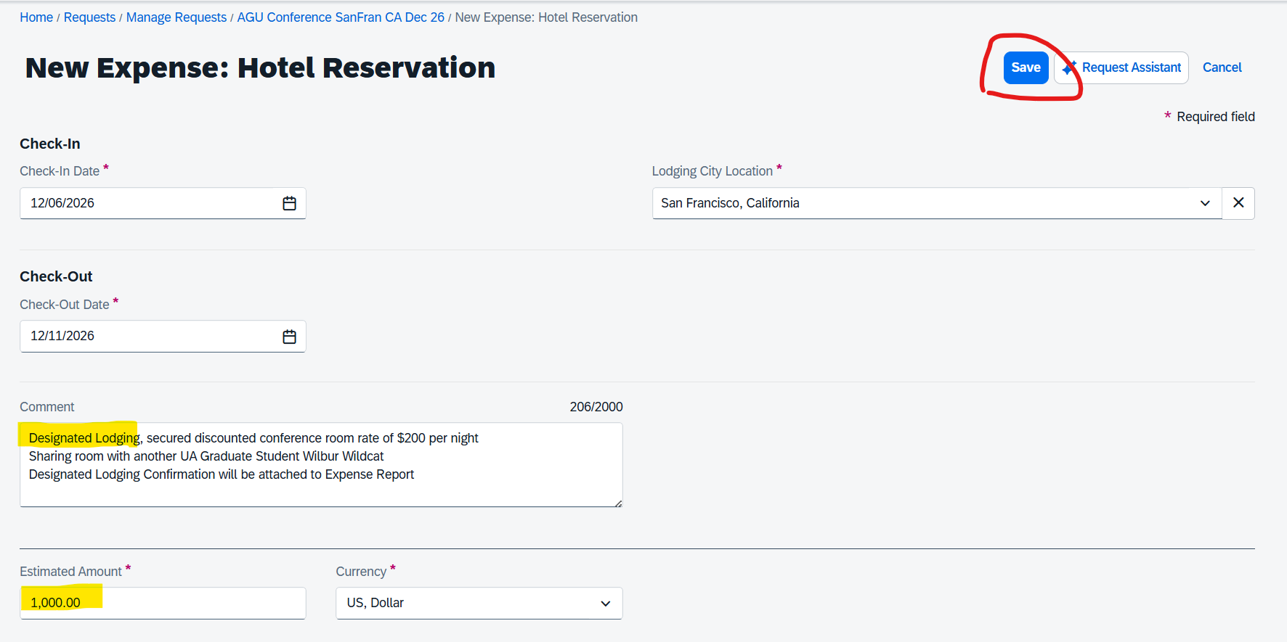

Slide 25
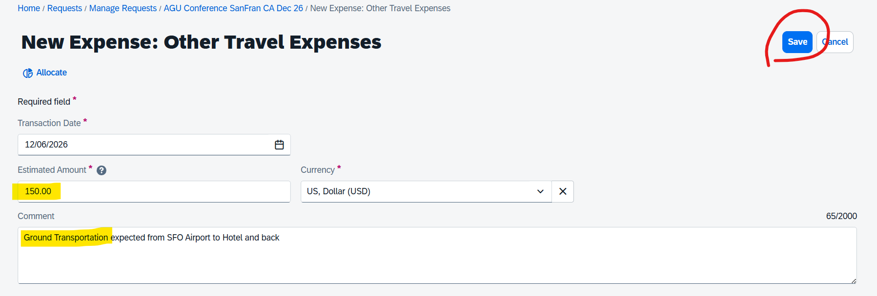

Slide 26
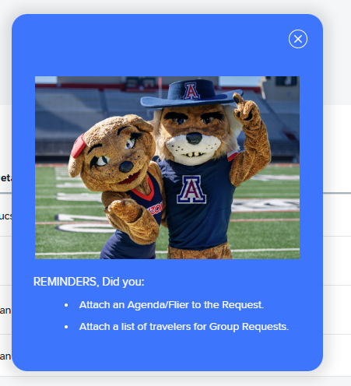
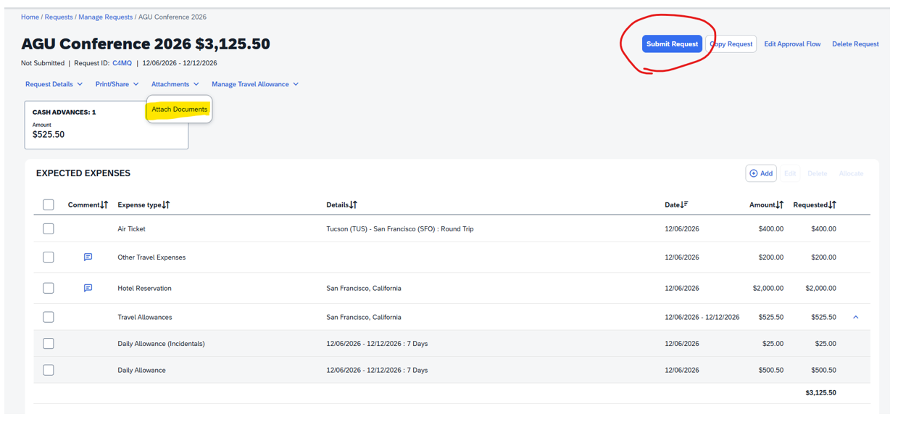
ADD CONFERENCE / MEETING AGENDA OR INVITE LETTER IN ATTACHMENTS

Slide 27

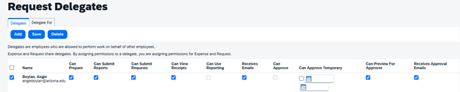
CONCUR PROFILE - DELEGATES
Click your initials at the top right
Next click on Request Settings, then the 2nd option is Request Delegates
Click the delegates tab then Add, type in angieboylan and barnettc and our names will show
Then on the left of our names check the box
Then click all the boxes shown below

Slide 28
PERSONAL TRAVEL
If you wish to include Personal Travel as part of your UA Business Travel, you –
CANNOT use your University Card for any travel expenses
At time of booking airfare, you need at least two flight comparisons for return airfares for only business appropriate date portion of the airfare
Airfare comparisons should be direct with airlines not 3rd party sellers like Expedia or Booking.com and for similar departure
and return times

Slide 29
Commercial Airlines Policy
Airline travel is limited to the cost of the most direct and economical route, ensuring minimal expense to the University.
Economy-class fare or the airline carrier’s equivalent of airline tickets are generally considered the most economical option. Travelers should select airfare that is both economical and reasonable. Comfort-based upgrades for air travel are not permitted with University funds.
An itemized receipt showing the passenger’s name, flight number(s), flight dates, and class of service is required.
The University will only reimburse Travelers for out‑of‑pocket expenses; vouchers, promotion, credits discounts, mileage earned, or rewards used at no cost to the Traveler are not eligible for reimbursement
Non-economy fare is allowed only when the Traveler has a documented medical need on file with the (DRC) that requires an upgrade. In all other instances, the following applies to single flights (individual legs or segments):
  For single flights under six continuous hours, Travelers may only select economy class or main cabin fares that allow standard seat selection without an upgraded seating class or additional premium travel benefits. Travelers must choose the most direct and economical option available.
  For single flights between six and 10 continuous hours, employees may upgrade to economy plus or equivalent categories (e.g., extra legroom, preferred seating).
  For single flights over 10 continuous hours, employees may upgrade to business class with written approval from their college dean or division senior leader. The written approval must document the business purpose for the upgrade and be attached to the Travel Request. Senior leaders must receive approval from their immediate supervisor.
  Additional considerations: When requesting an upgrade for flights of six continuous hours or longer, additional travel logistics may be required, such as booking individual travel segments at different class categories.
If a Traveler chooses to purchase a higher class airfare, the excess cost is considered a personal expense and is not allowable on University funds or eligible for reimbursement. To determine the reimbursable portion, the Traveler should provide documentation from the time of booking showing the lowest economy-class fare available for the most direct and economical route that would have met the Traveler’s scheduling needs and the business purpose of the trip. The Traveler is responsible for paying for a higher-class fare with personal funds and may seek reimbursement only for the business appropriate portion of the airfare (i.e., the equivalent economy‑class fare) through the Travel Expense Report after completion of the trip.
The use of personal frequent flyer miles, points, or vouchers for University business travel may not be claimed by the Traveler as a reimbursable expense.
Use of federal or sponsored funds must always comply with both University and sponsor-specific policy.
When federally sponsored funds will be utilized for travel, refer to the "Fly America Act," which requires Travelers to use U.S. flag air carriers regardless of costs or convenience.

Slide 30
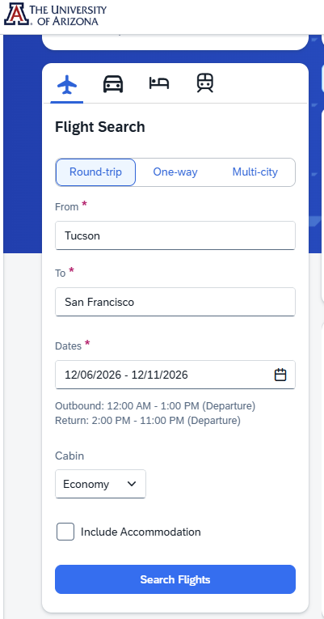
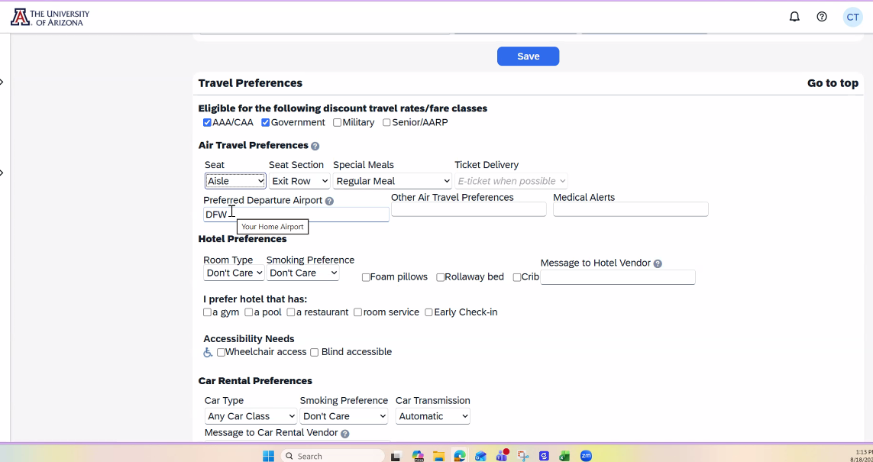
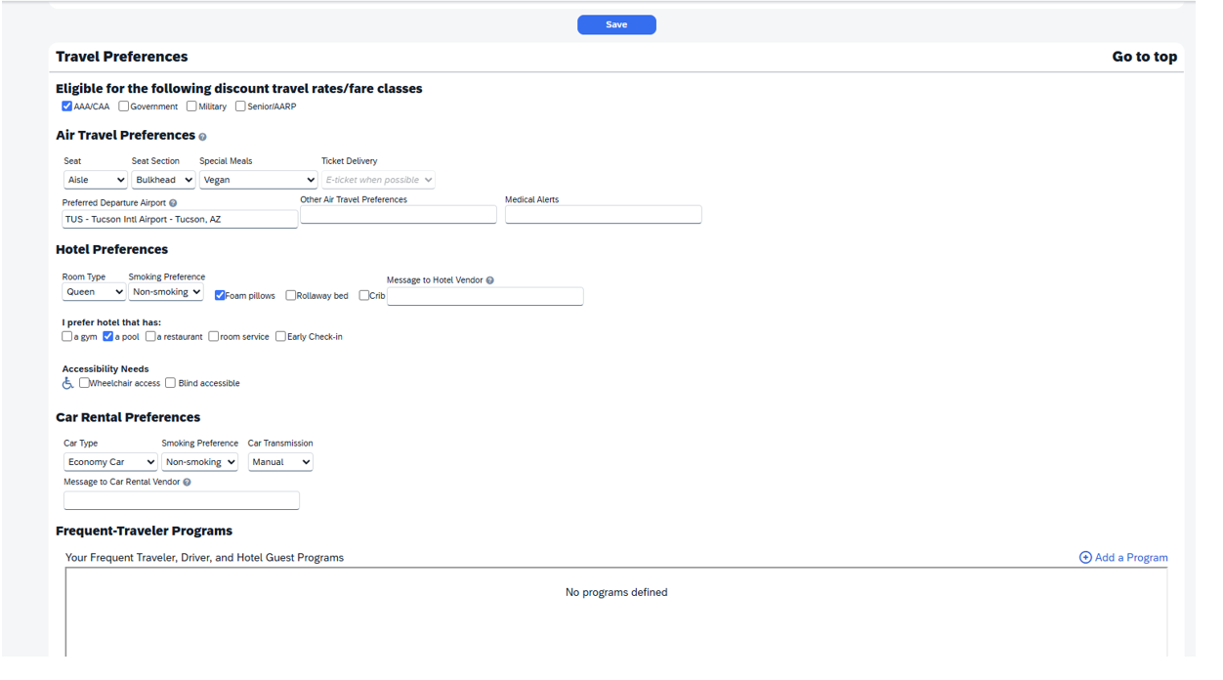
Concur Booking Tool – Anthony Travel
Use for Airfare only, not lodging or rental vehicles
Using the Booking Tool incurs a $3 agent fee for any ticketed airfare
Cannot be used if personal travel is included
Profile Name must match your Passport / Traveler Name
Ensure your cell number is on your profile
Include preferences and airline member / advantage numbers, TSA PreCheck, Known Traveler Number etc on travel profile
WATCH DEMO
HERE

Slide 31
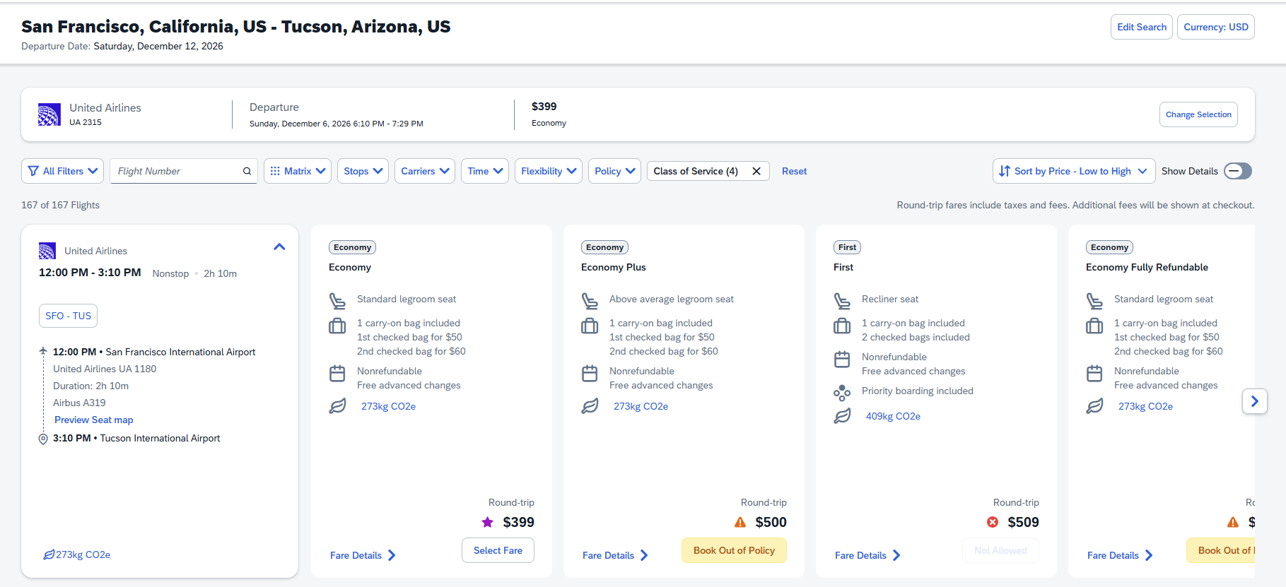

Slide 32
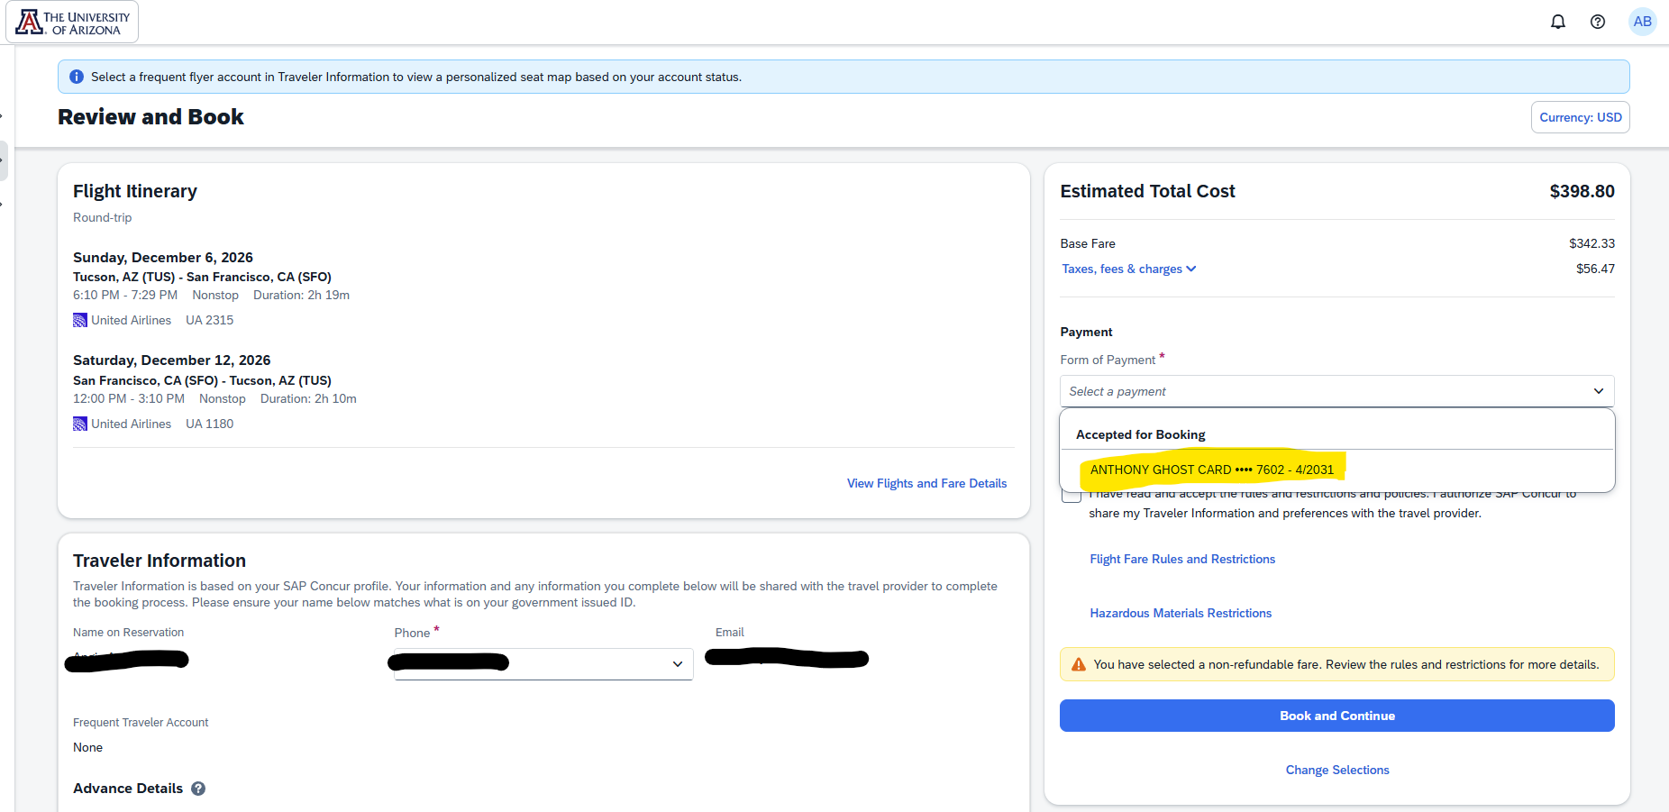
** NOTE – You cannot use the Anthony Travel Ghost Card if you hold a Univeristy OneCard / TravelCard, you must add your own University Card to use for payment **

Slide 33
STUDENT TRAVEL
Student who are required to travel for UA business can only:
Use Anthony Travel booking tool in Concur for airfares
Request accommodation be prepaid using UA virtual card
Request a Travel Advance for M&I costs
OR pay all costs on personal card for reimbursement POST travel
PI’s CANNOT pay for any travel expenses for their students on University Cards (unless a Group Travel Arrangement on OneCard)
When approving Travel Requests for Students as PI’s, please ensure Account Numbers are correct, all estimated expenses included, detailed business purposes are provided

Slide 34
REMINDERS
Business Purposes must be detailed – Include WHO, WHAT, WHERE, WHEN, WHY & HOW it benefits the University and/or the Account expensed
Per Diem is now referred to Travel Allowance and it broken out into a Daily Allowance amount & $5 of Incidentals
It is NOT recommended to use your OneCard/TravelCard for meal purchases while traveling
For ‘Designated Lodging’ on your trip, please include attachment to verify
Ensure your conference/meeting agenda/itinerary is attached
If Tucson is your Base location, you must fly out of TUS, unless detailed justification AND flight comparisons, including any travel and parking costs are provided

