Slide 1

Travel Guidelines

Slide 2

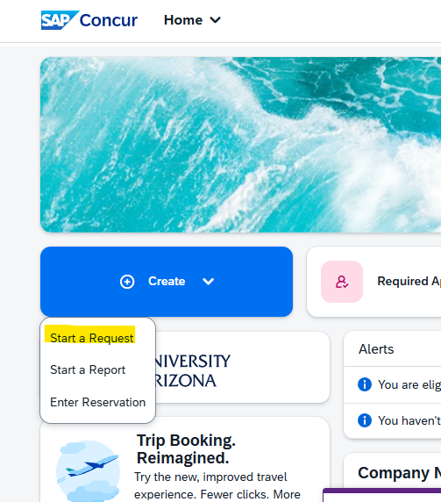
For any travel out of Tucson, AZ (your base)
Open Concur -
https://us2.concursolutions.com/home.asp
Create a Travel Authorization Request and enter as much detail as possible
Once completed, this request is sent to your PI or dept head for approval, then to your fund approver

Slide 3
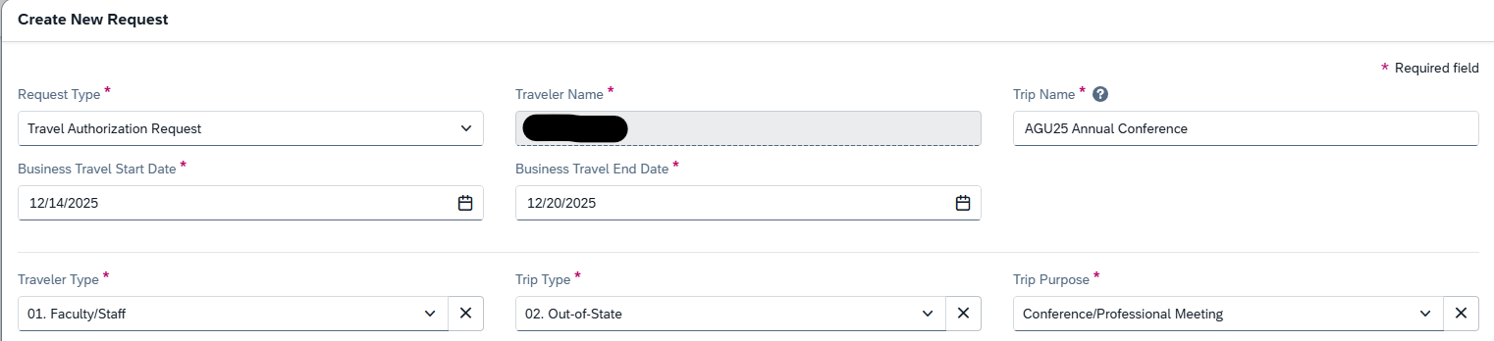
Note
Your Traveler Name should auto populate if you are signed into your Concur account.
Enter your Trip Details e.g. Name of Conference / Workshop you will be attending.
Ensure your Business Travel Start Date is the date you intend to leave Tucson, not the start of the conference.
Likewise, your Business Travel End Date should be the date you plan to arrive back in Tucson.

Slide 4
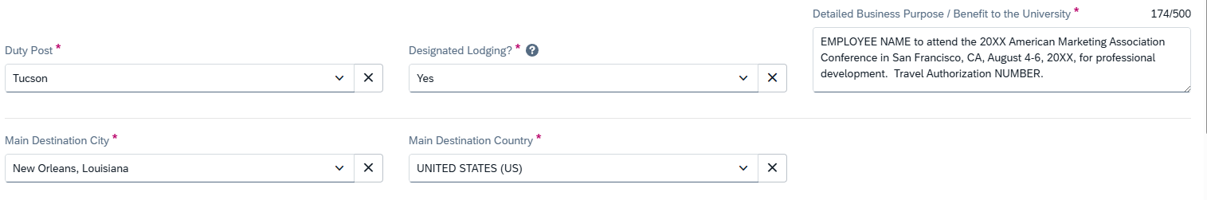
Note
If the conference or meeting you are traveling for provides designated lodging, please indicate yes in this section. This is VERY important when processing lodging payments as ONLY designated lodging costs are allowed to be greater than the State of AZ max lodging rates. If you choose your own hotel and the base room rate exceeds the max lodging rates as per the guidelines for the location you stay the night, you will NOT be reimbursed more than the max lodging rate https://gao.az.gov/sites/default/files/2025-01/5095%20Reimbursement%20Rates%20250127.pdf
Your Business Purpose MUST be detailed and thoroughly explain as to how this travel benefits the university (not yourself) for FSO to reimburse. Please include all dates and locations for the conference. FSO Guidelines link- https://finance.arizona.edu/accounting/business-purpose

Slide 5
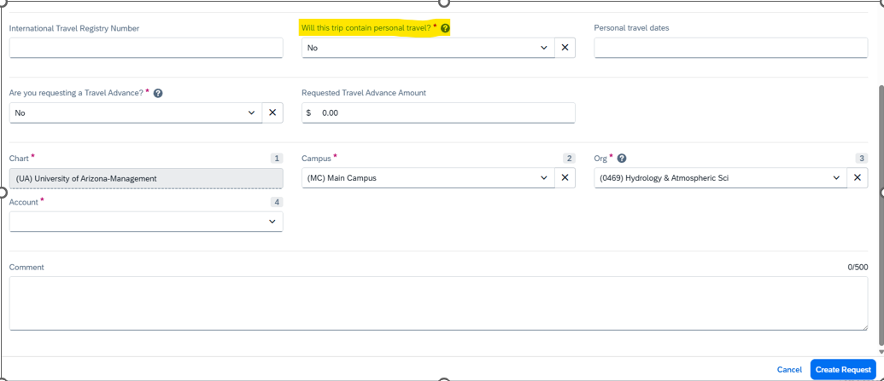
Note
If you plan to include personal travel in your trip, you must put YES on this highlighted question. Any lodging, meals or additional costs during your personal travel time will NOT be reimbursed. You will also need to provide AT LEAST 2 flight comparisons for your flight date back to Tucson post conference verse post personal dates as only the lesser flight cost will be reimbursed. Include any additional details in comments.
If personal travel is being taken, NO travel expenses should be paid for by PCard – this is a violation.
Please ask if you have any questions!

Slide 6
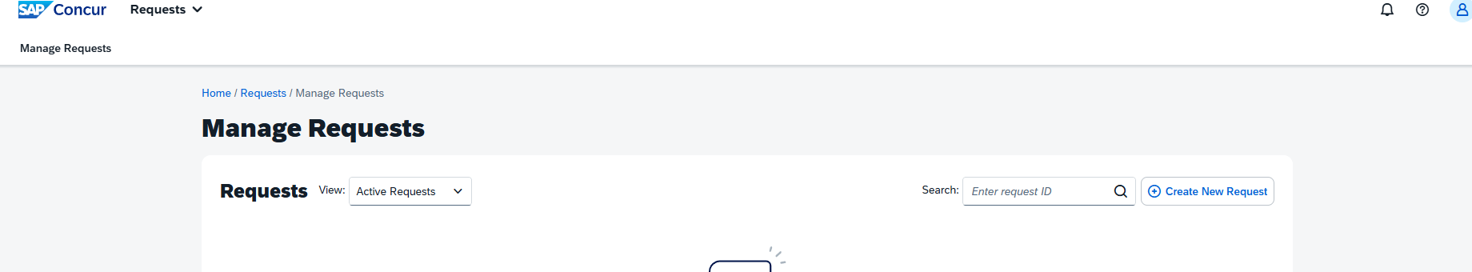

** You can view your travel authorization requests at any time in Concur to track when it has been approved or canceled etc **

Slide 7
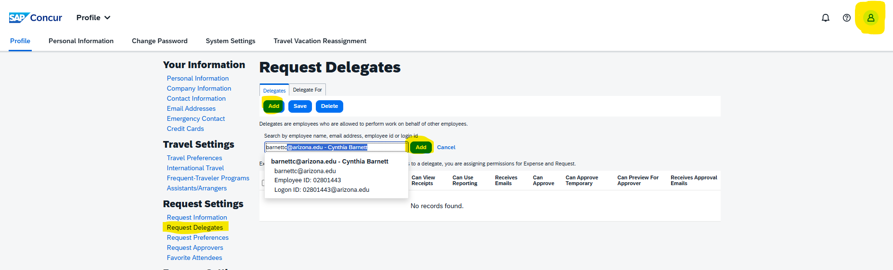
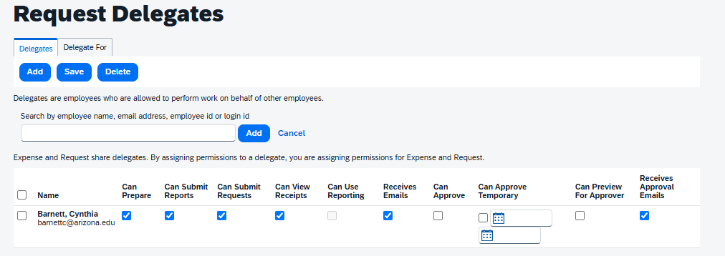

In your Concur profile settings (highlighted top right), you can ‘Request Delegates’ (highlighted far left), click add, enter name of person (e.g. Cindy) you wish to add as a delegate for you and add permissions, example below. This allows the business office to assist you with the processing of your travel expenses. Hit save after adding permissions.

Slide 8
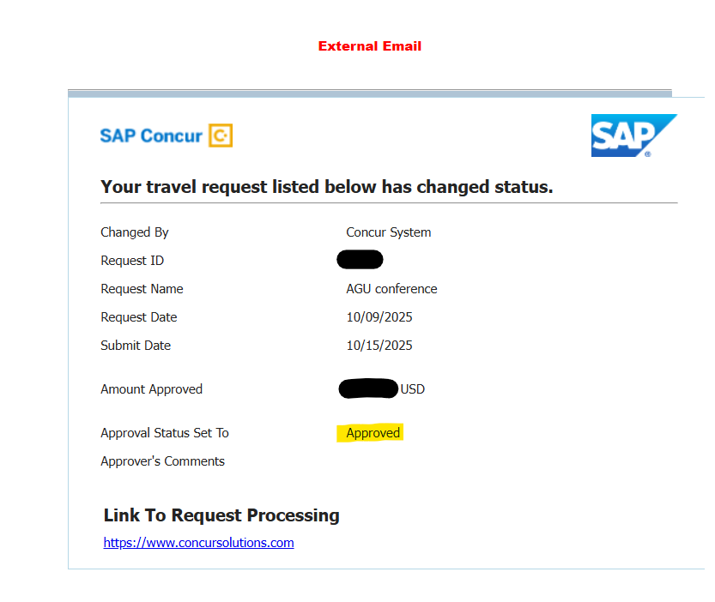

Once fully approved you will receive an email showing Approved status (highlighted) and the amount approved for travel expenses in USD.
Note The Request ID (highlighted) is the 4 digit alphanumeric ID which is your Travel Authorization (TA) number (blocked out in this example but an example is 6ABC.
This ID number should be added to all future documentation including Smartsheet Travel Expense Claims.

Slide 9

During your trip ensure you keep ALL receipts. These receipts must be fully itemized showing what was purchased, where and when in order to be reimbursed.
NOTE –
Tipping over 20% will NOT be reimbursed.
Alcohol purchases will NOT be reimbursed.
Rideshares / taxis other than to/from airport or to/from conference from lodging without justification will NOT be reimbursed. Reservation fees, cleaning fees, and wait time charges for taxis and rideshares will NOT be reimbursed without a university business purpose.
Meals cannot be claimed when provided during transit, by lodging or by meeting/conference organizer and will be deducted from M&I claims.
Airlines - Airfare reimbursed is for the most economical and direct route possible. Checked bag fees more than the allowable first bag are NOT reimbursable without a University business purpose. Specialty seating assignments or upgrades are not permitted unless a medical or physical necessity.
Internet, Wi-Fi, or hot spot fees are NOT allowed unless supported with a University business purpose.
Hotel personal phone calls, movies, or snacks are NOT permitted.
Rental Vehicle - Collision Damage Waiver, Loss Damage Waiver, and excess liability insurance must be declined and are NOT reimbursable without a University business purpose (e.g., traveler is on foreign travel status). Utilizing existing University rental company contracts, which include full insurance, is strongly encouraged. All gas receipts must be kept.
During foreign travel where receipts are in foreign currency, please include the equivalent USD amount charged to your credit card.

Slide 10
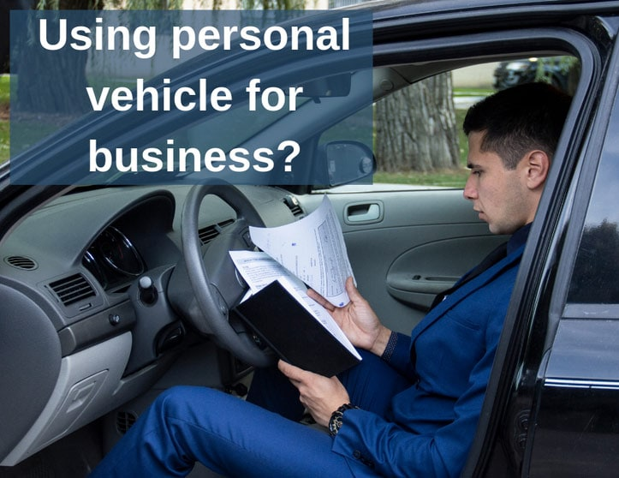
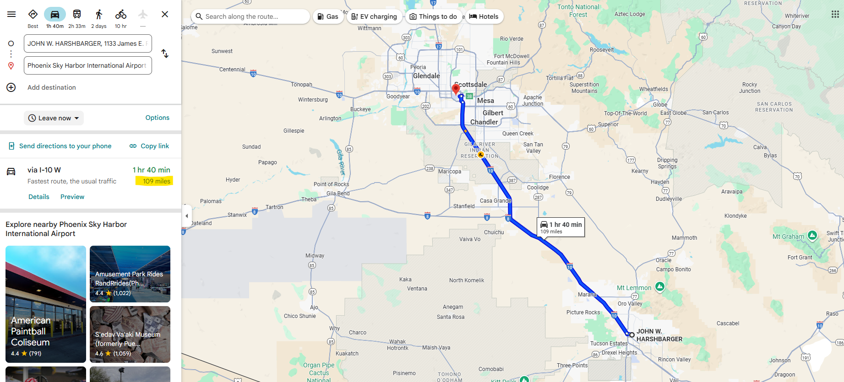
When using and claiming your personal vehicle during business travel :
You must have completed a Personal Vehicle Use Form
in advance Personal Vehicle Use Form.pdf
If unsure, please check with Cindy to confirm current form is on file.
Mileage is reimbursed at 0.67 cents per mile.
When submitting for personal mileage travel reimbursement,
be sure to include either odometer readings or alternatively,
a google map image showing traveled miles claimed (example below).
Parking expenses incurred at a convention center for a conference will be accepted. However, parking to buy dinner for yourself after the conference is not acceptable as it does not further the university’s mission.
Valet charges will NOT be reimbursed.

Slide 11
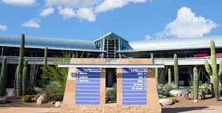
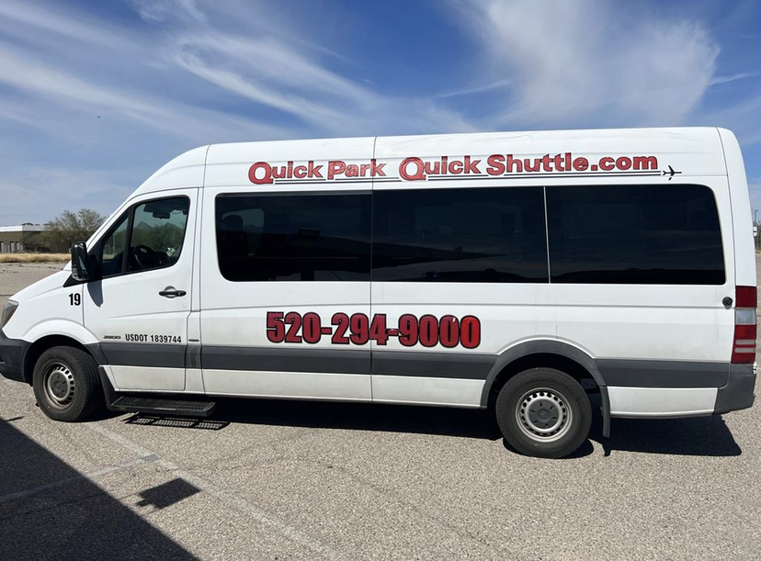
TUS Airport Parking Options
** REMEMBER -
Parking receipts
with details
will be required
(i.e. Location,
Date, Rate) **

Slide 12
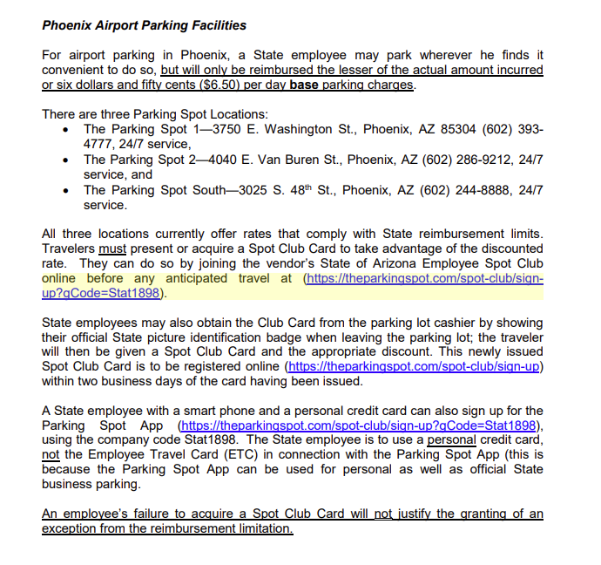

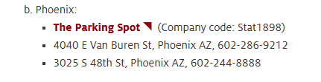
PHX Airport Parking Options
If you plan to fly out of PHX rather than TUS as there are greater flight options or more direct flights remember that you must provide flight comparisons AT THE SAME TIME you make your flight booking to prove there was a cost saving to justify flying out of a non-base airport.
The lesser cost difference of flying out of PHX vs TUS needs to include mileage AND parking costs involved with getting to PHX.
When flying out of PHX, note parking costs will only be reimbursed to a max of $6.50 per day. This is only attainable by using The Parking Spot Club Sign Up and creating an account using Corporate Account code Stat1898.

Slide 13
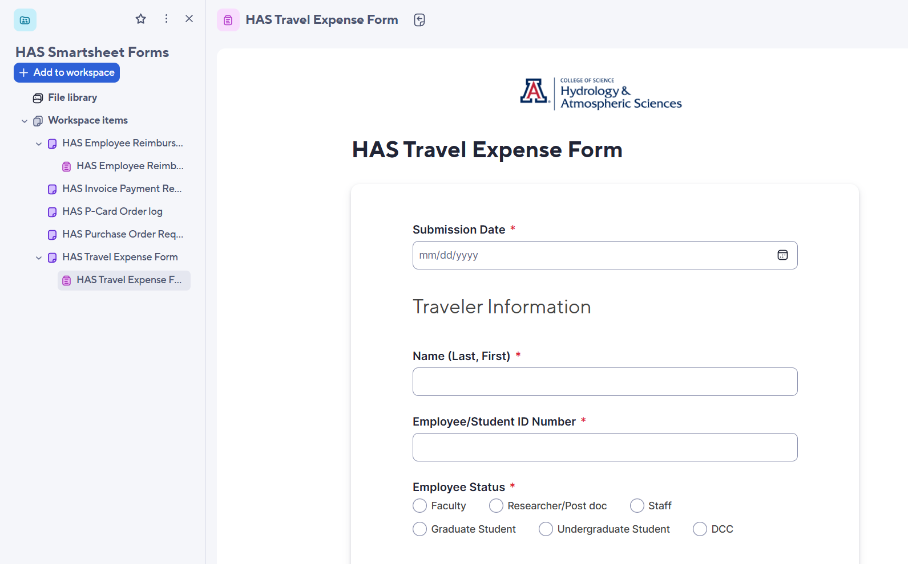
After the completion of your travel, you will need to complete a Travel Expense Form (link below) to claim reimbursement for your airfare or lodging (if not already paid on a Pcard), transportation, parking costs and M&I (meals and incidentals).
HAS Travel Expense Form Complete all sections with a red asterisk.
**Ensure you submit a Travel Expense Form NOT an Employee Reimbursement Form for anything travel related!**

Slide 14
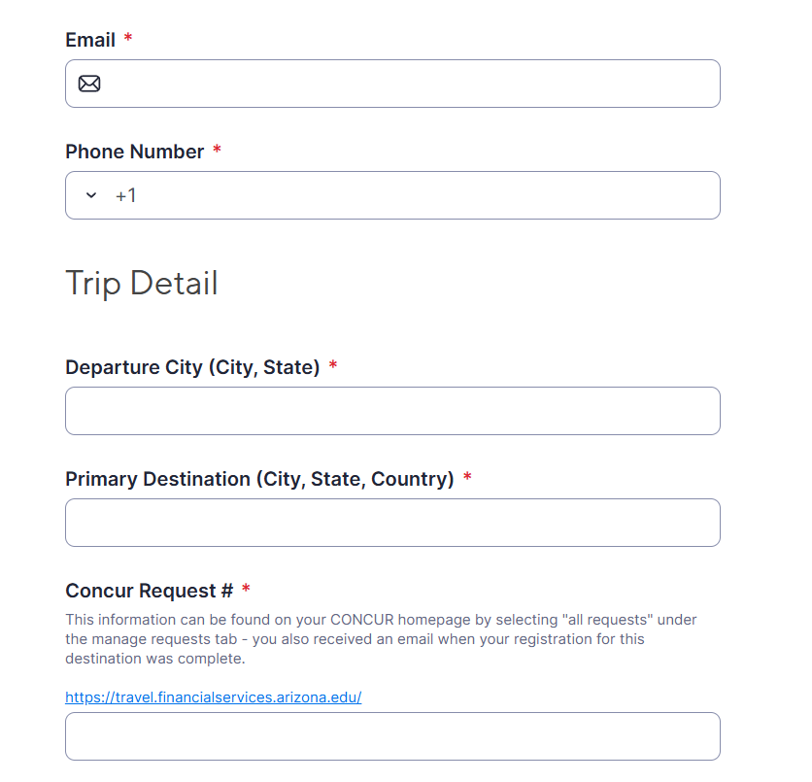
Travel Expense Form continued –
Complete your contact details and trip details with departure and destination city information.
Your Concur Request # is your 4 alphanumeric ID (example 6ABC).

Slide 15
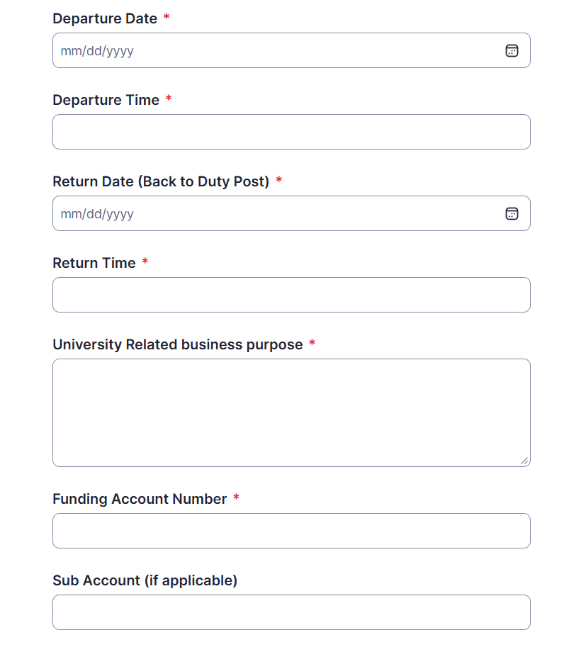


Travel Expense Form continued –
Enter Departure / Return date and time (usually based on flight details)
University Business Purpose MUST be detailed and how these travel expenses benefit the University or specific grant (not for personal gain)
Account Number – provided from your PI
FSO Accepted business purpose example – EMPLOYEE NAME to attend and present findings at the AGU25 Conference in New Orleans, LA on December 15-19, 2025, for professional development and collaboration with emerging leaders. Travel Authorization 6ABC
FSO Rejected business purpose example –
Attended AGU Conference OR
I traveled to workshop to gain knowledge for my thesis.

Slide 16
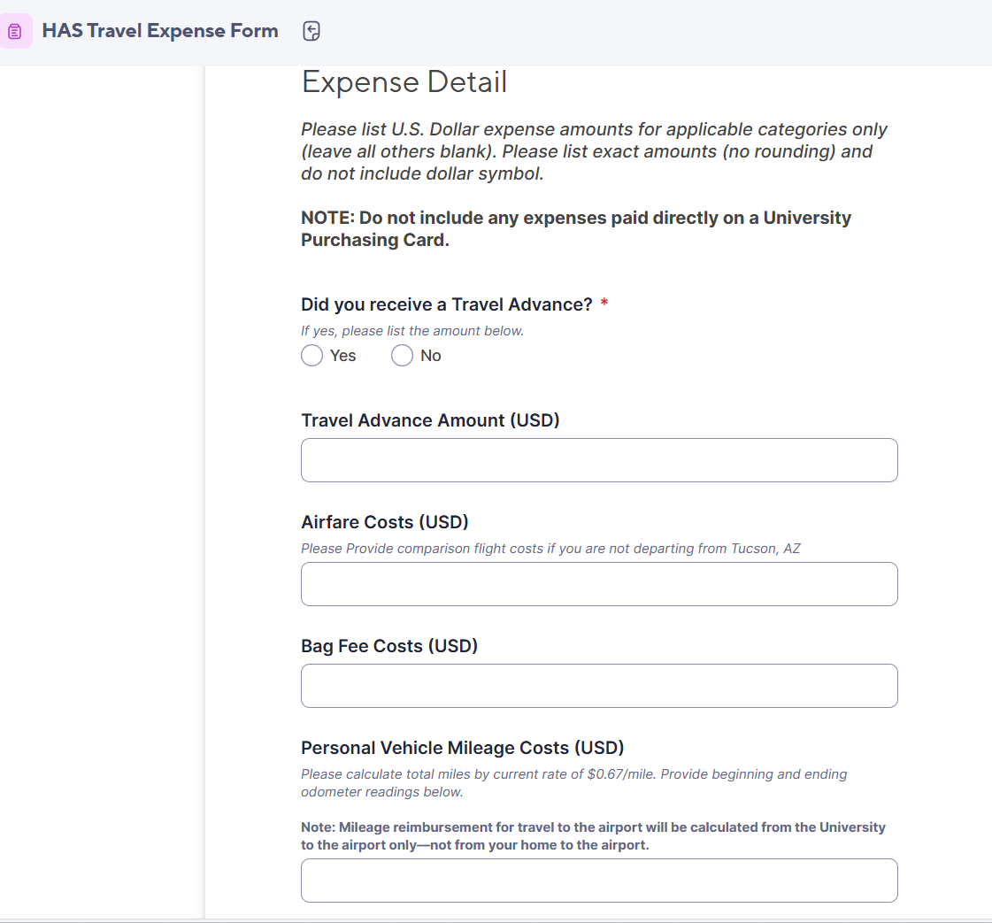
Travel Expense Form continued –
Enter any expenses that were incurred including airfare, bag fees or mileage costs in relevant section
If you did not receive a travel advance, leave this section blank

Slide 17
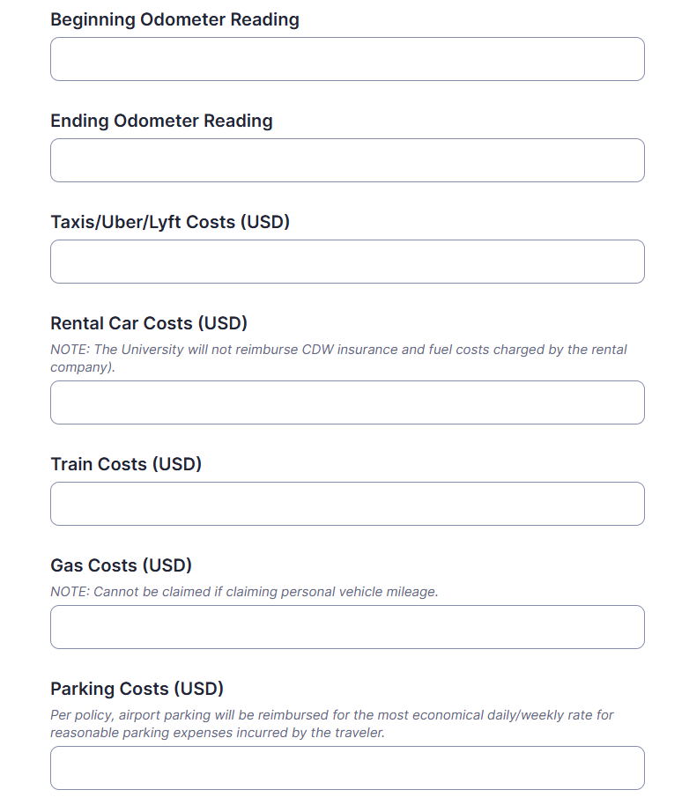
Travel Expense Form continued –
Enter odometer reading for mileage reimbursements if personal vehicle was used, enter TOTAL amount of taxi / rideshare costs in USD, enter other transportation or parking costs in the relevant section

Slide 18
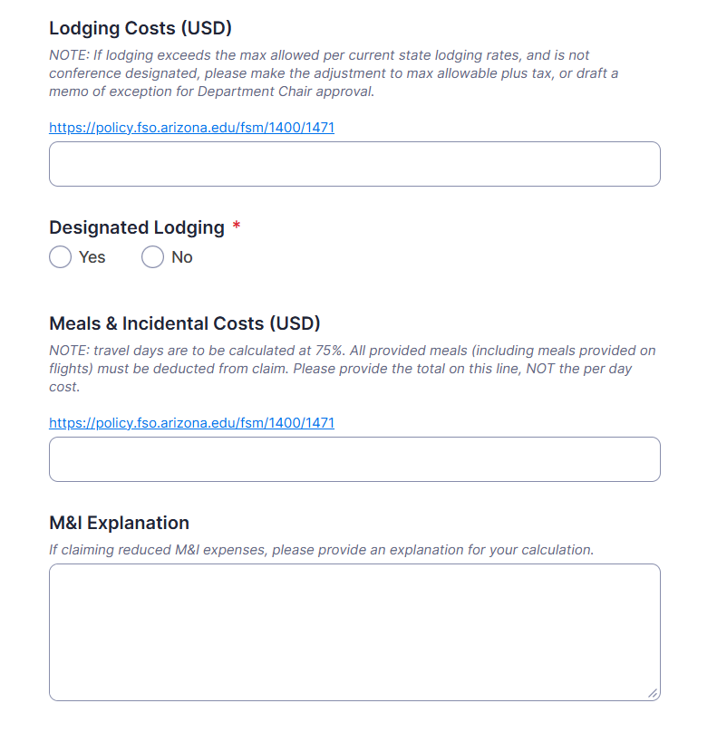
Travel Expense Form continued –
Enter total amount of lodging costs in USD (see note regarding max allowable), whether lodging was designated as part of your conference / meeting. Ensure NO incidentals are included on your lodging bill.
M&I costs can be difficult to accurately calculate, if you are unsure but wish to claim per diem, please write a note in M&I Explanation box as to which days you wish to claim, and if any meals were provided by airline / hotel / conference during your trip and we can calculate for you.
e.g. I only wish to claim 2 days per diem OR I would like to claim full per diem less hotel provided breakfast and lunch which were provided by my conference each day as well as one provided dinner on December 18.

Slide 19
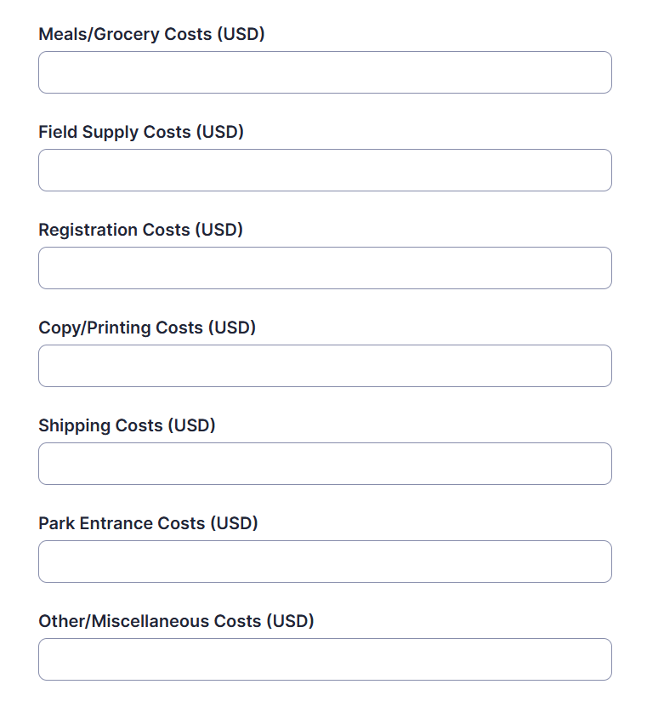
Travel Expense Form continued –
Only enter any additional expenses which you incurred during your trip in the relevant section (itemized receipts must be provided to match amounts)

Slide 20
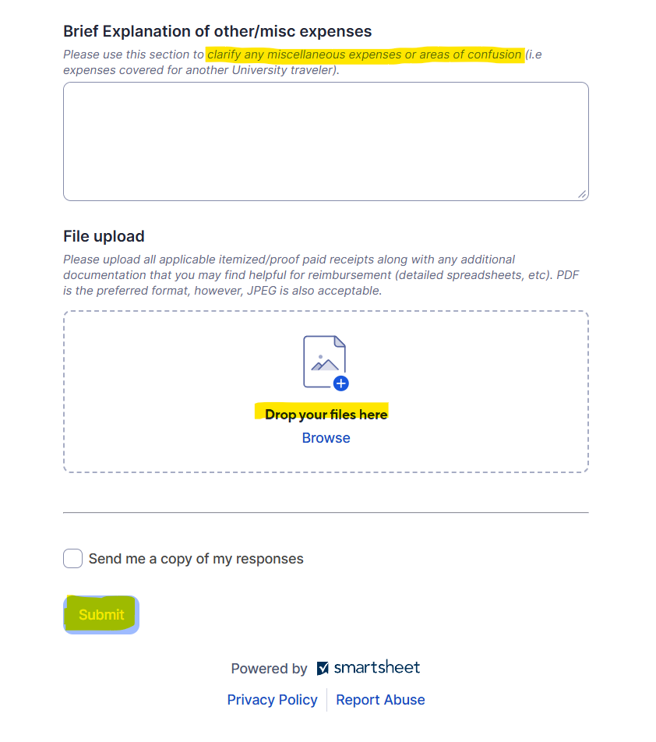
Travel Expense Form conclusion –
Explain any additional expenses or if you are unsure about any other part of your travel expenses in the top section
Add ALL receipts in the file upload section. You do not need to include any receipts that have already been paid previously on PCard transactions
Include any additional information like conference flyer and designated lodging information or information outlining conference meals that were provided
Lastly, check box if you wish to receive an email copy of your Smartsheet (highly recommended!) before clicking SUBMIT

Slide 21

After submitting your travel expense claim –
Angie Boylan angieboylan@arizona.edu or Elian Martinez elianmartinez@arizona.edu from the Earth Sciences Business Office reconciliation team will be in touch if you are missing any information or if they have any questions about your travel and / or claim.
Once everything is reconciled, you will receive a Travel Expense Report requesting your digital signature via email. Once signed, it is sent for approval and finally for payment.

